Slide 1

Team M gogogo

Slide 2

Team Introduction
Role | Tech Lead | UXUI | QA | BA | DEV
Day1 | Marie | Vincent | Jenny | Chris | Alan, Thomas, Heinrich
Day2 | Marie | Vincent | Heinrich | Jenny | Chris, Alan, Thomas
Day3 | Marie | Vincent | Thomas | Heinrich | Jenny, Chris, Alan
Day4 | Marie | Vincent | Alan | Thomas | Heinrich, Jenny, Chris

Slide 3
Team Introduction – Roles and Responsibilities
Team Lead
Business Analyst
Responsible for the technical troubles of the team
Ensure all the agile activities happen
Control the progress and guide the priority
Clarify Requirements through the communications
Communicate with PO and the team
Manage the IPM
Collaborate with QA and DEV in Story Kickoff and Desk check
Ensure everyone has a clear and consistent understanding of the story cards
UX/UI
Researching, designing, and implementing all user experiences
QA
Collaborate with BA and DEV in Story Kickoff
Make sure the story card contains all the information and has clear description and ACs
Collaborate with BA and DEV in Desk check
Ensure that all ACs are implemented, and all functions are working properly through QA testing
Developer
Developing, coding, installing

Slide 4
Current Problem
Traditional movie ticket purchasing

Slide 5
Pain points
Choose a movie session
Buy a movie ticket
Got to watch the movie
No friends free to watch together
No friends free to watch together
Forgets about the movie time and date
No friends like to watch that movie
Takes time to queue in cinema for ticket and snacks
Lost or damage movie ticket

Slide 6



Current Problems
Slow ticket purchasing
Hard to find Companions
Forget about time and ticket
Hard to find people with similar interests

Slide 7
Product
Introduction
An Interactive Movie Ticket Reservation Website

Slide 8
Fast
Friendly
Find your match

Slide 9
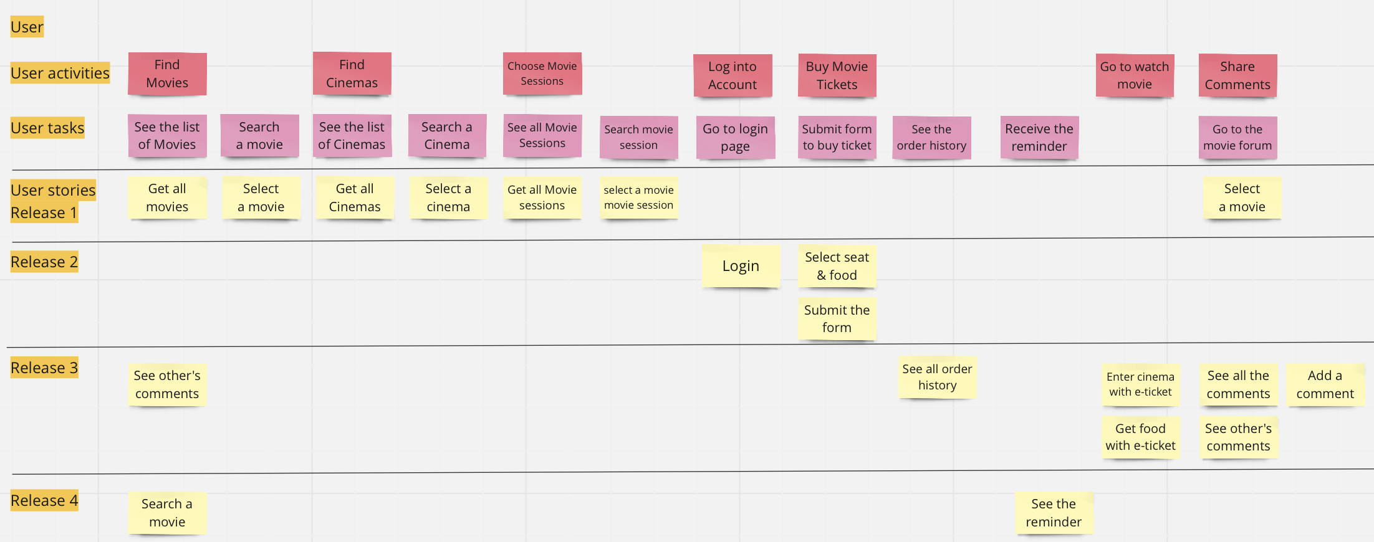
Product Introduction – User Story

Slide 10
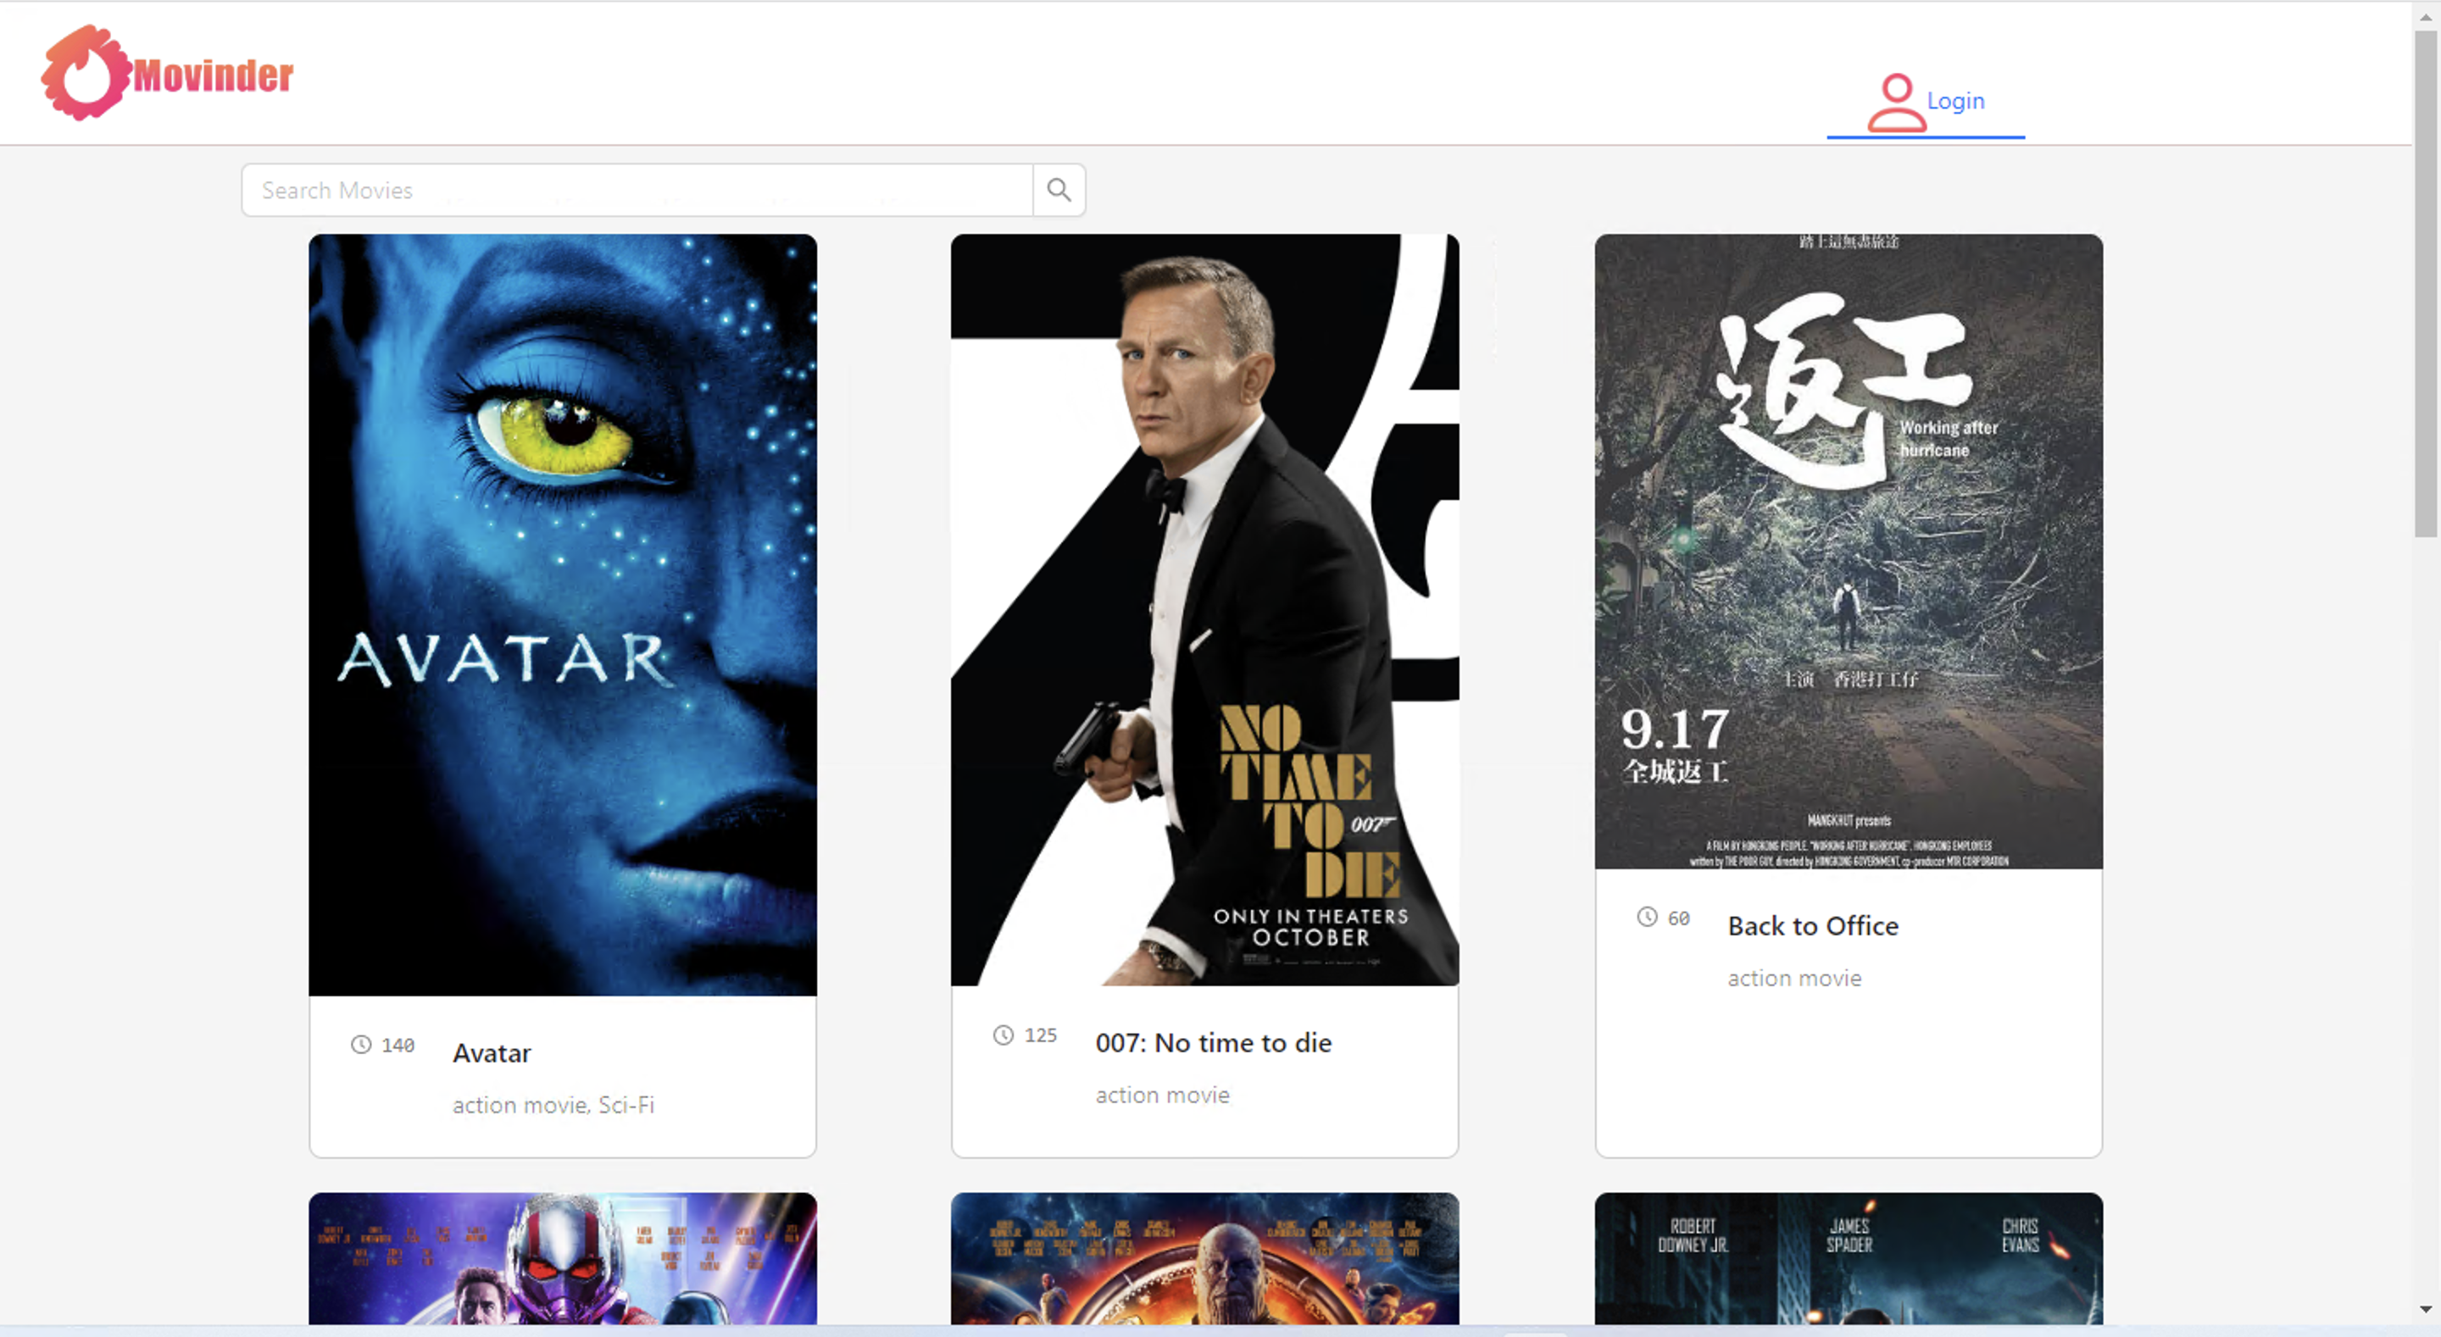
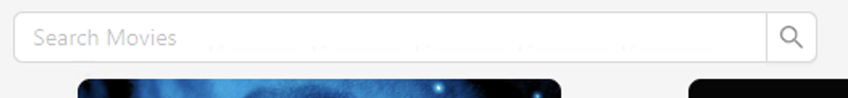
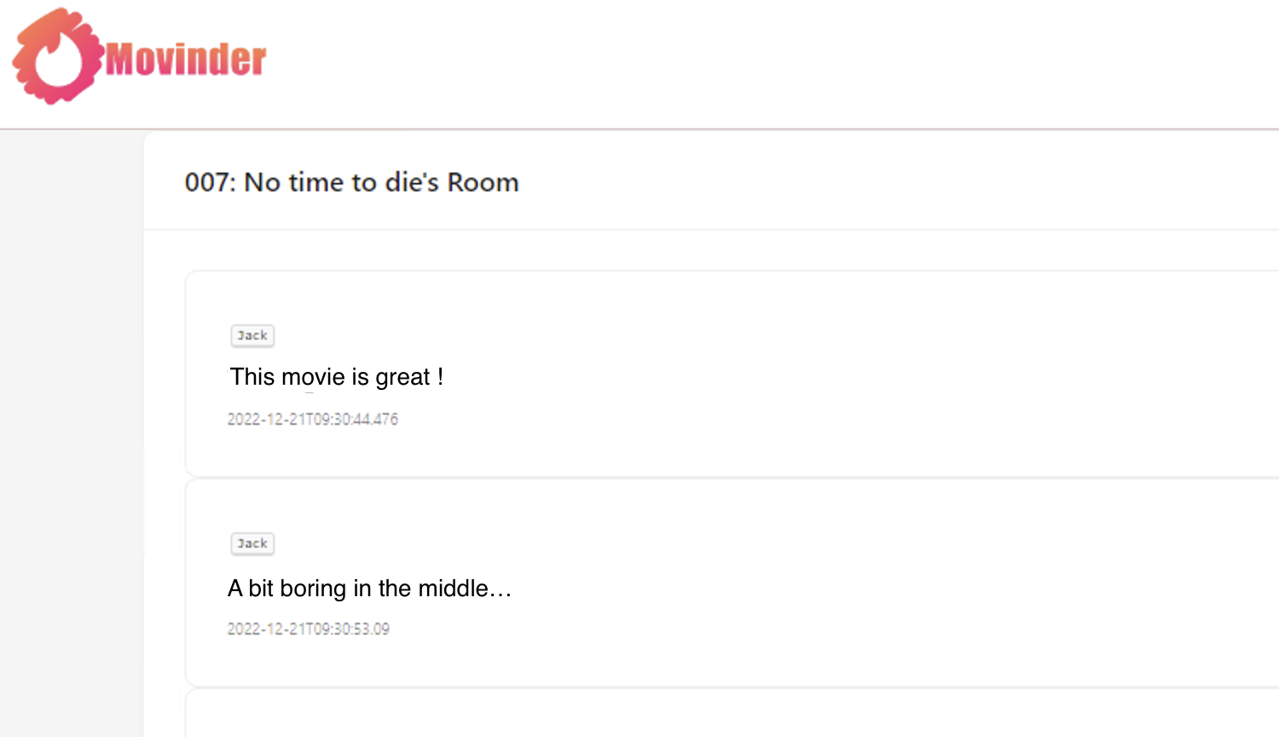
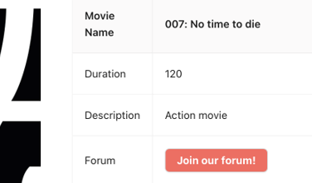
Find Movies
Find Cinemas
Choose Movie Sessions
Login Account
Buy Movie Tickets
Waiting
Go to watch movie
Share Comments
User Activities

Slide 11
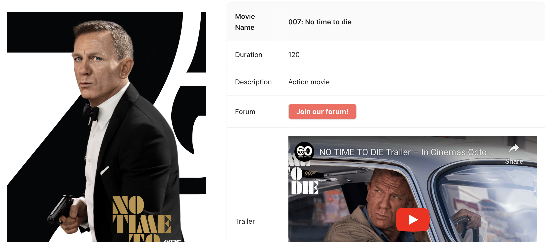
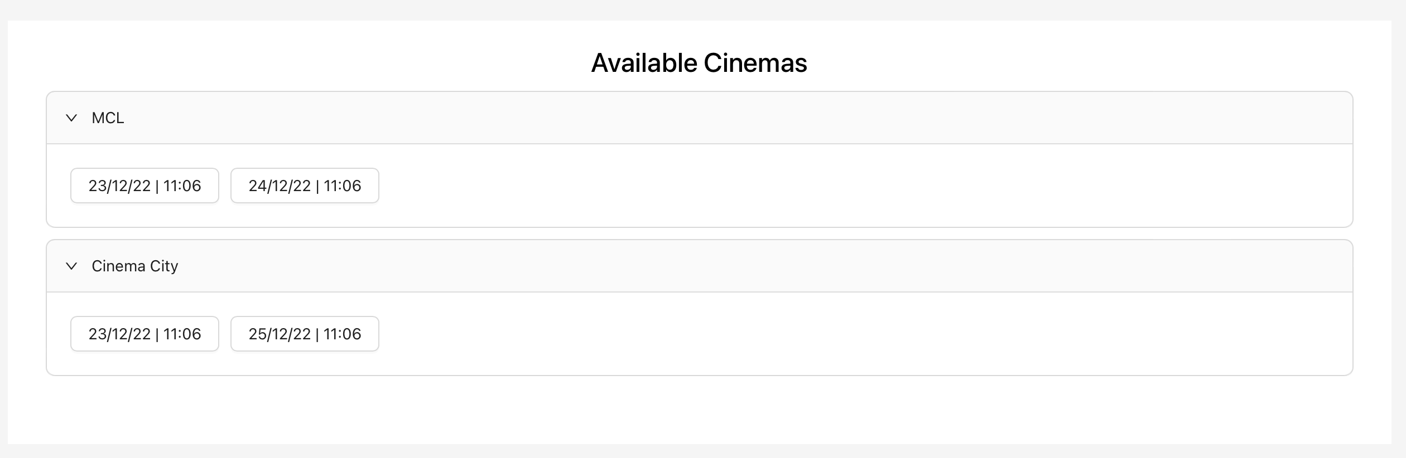
Find Movies
Find Cinemas
Choose Movie Sessions
Login Account
Buy Movie Tickets
Waiting
Go to watch movie
Share Comments
User Activities

Slide 12
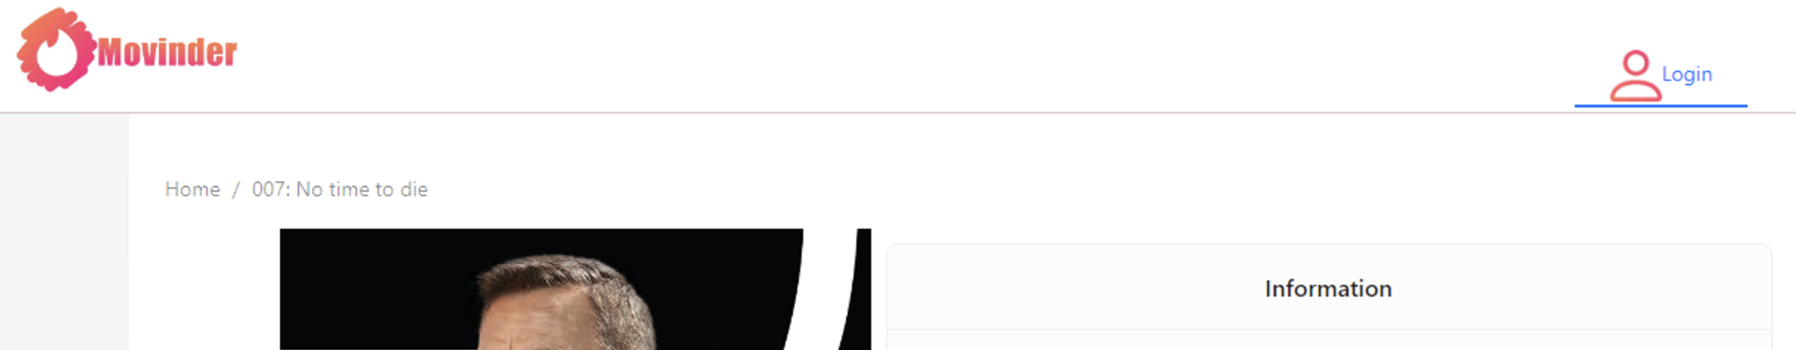
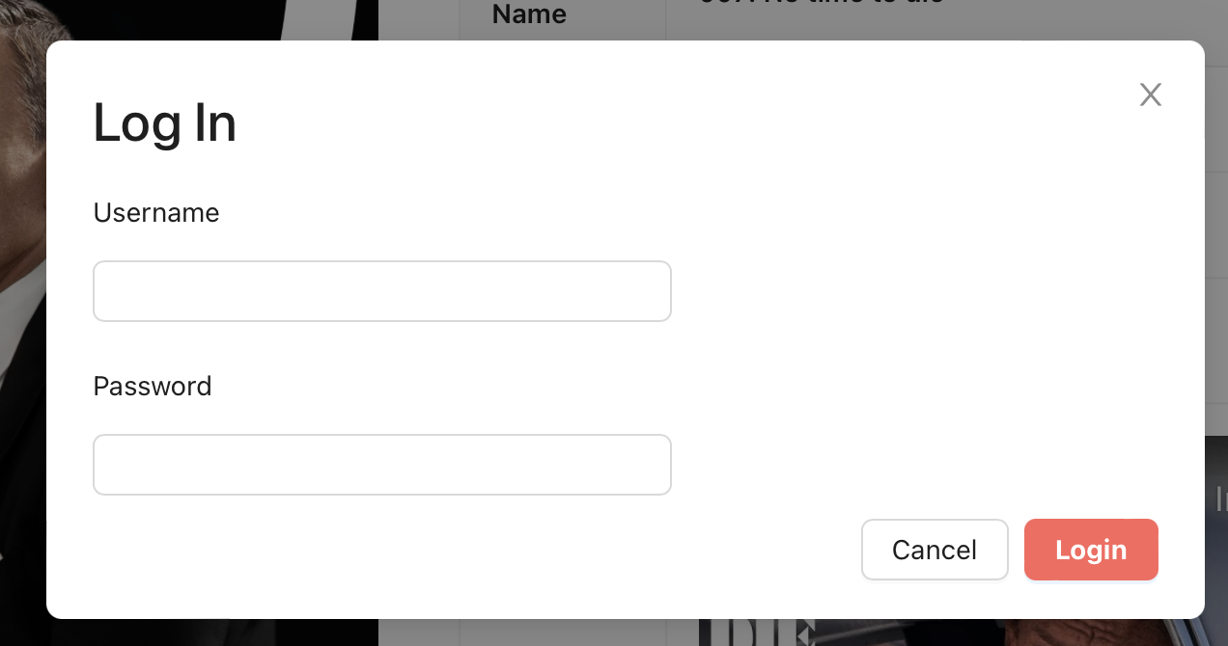
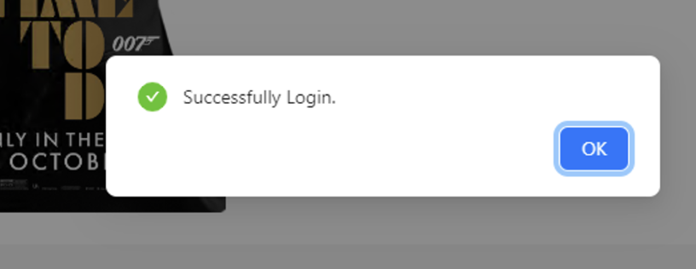
Find Movies
Find Cinemas
Choose Movie Sessions
Login Account
Buy Movie Tickets
Waiting
Go to watch movie
Share Comments
User Activities

Slide 13
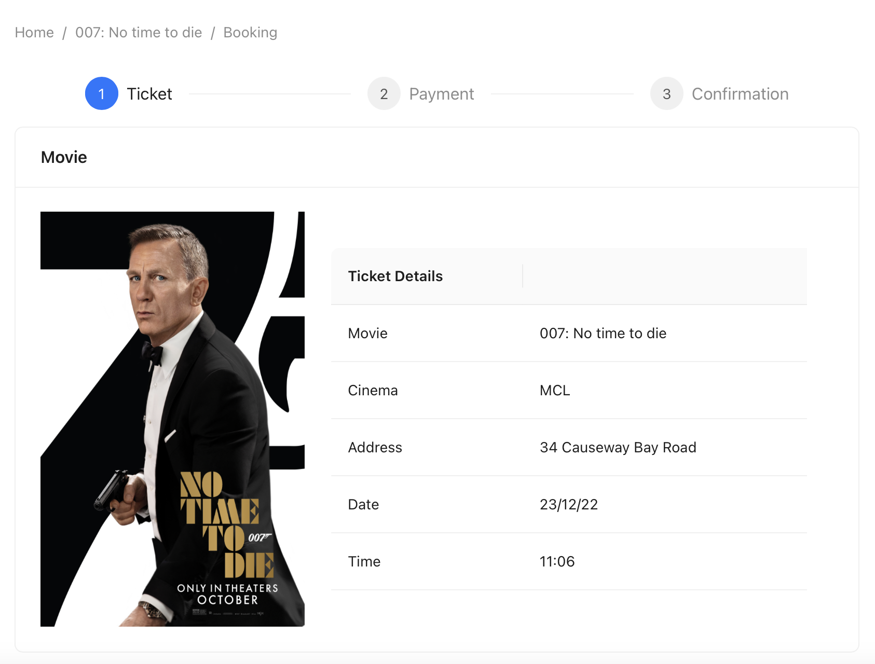
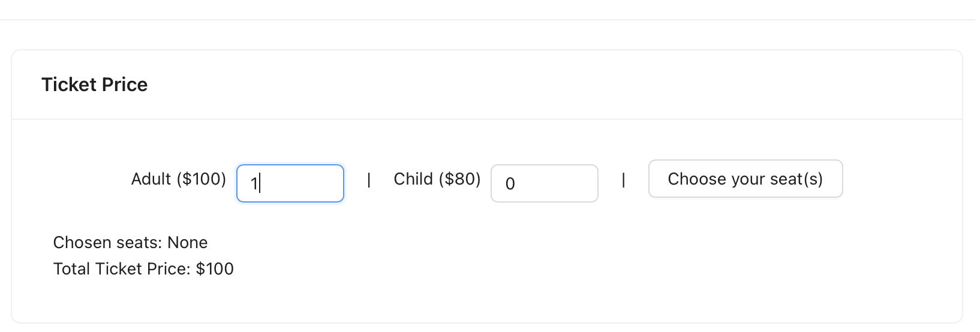
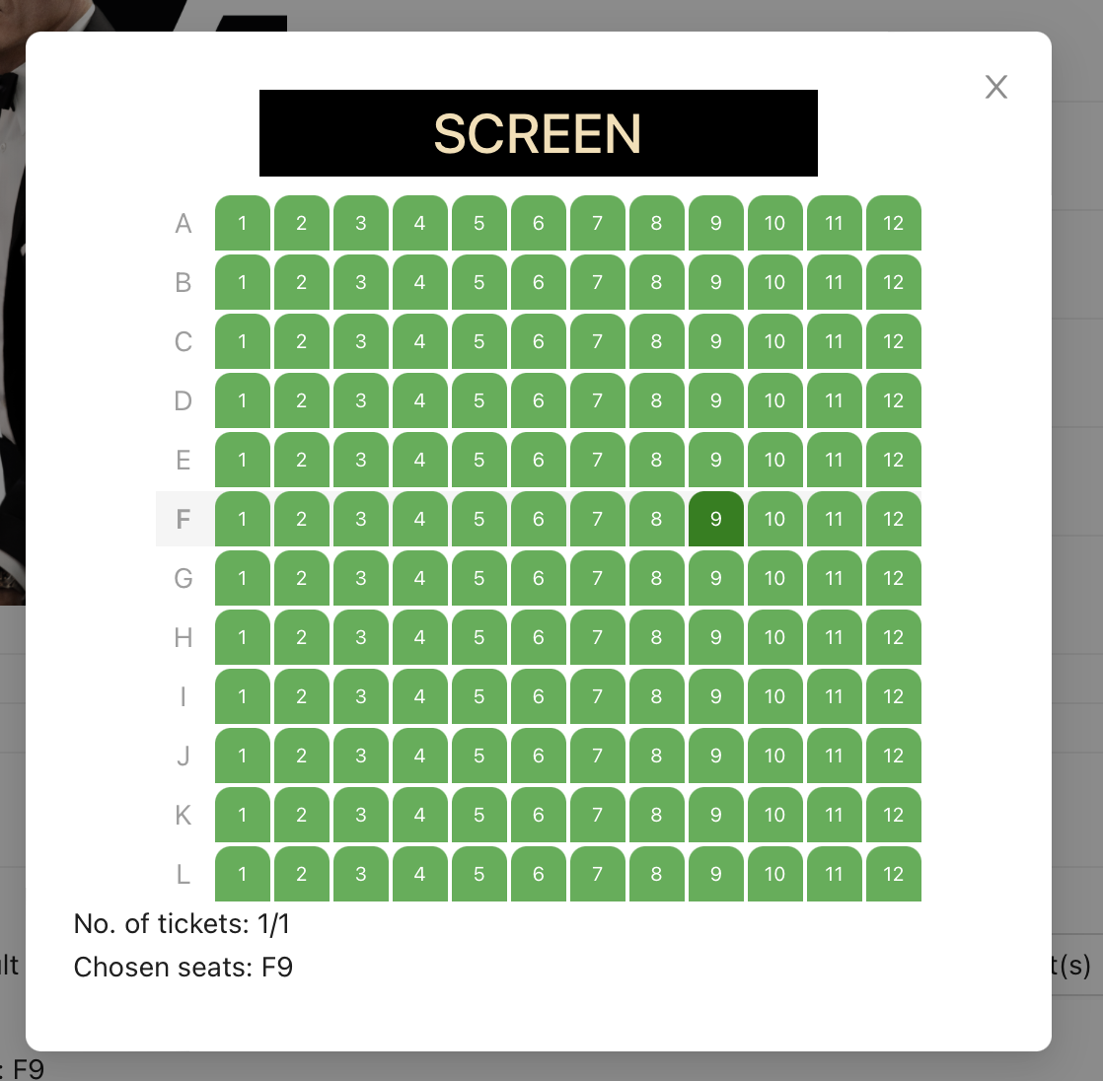
Find Movies
Find Cinemas
Choose Movie Sessions
Login Account
Buy Movie Tickets
Waiting
Go to watch movie
Share Comments
User Activities

Slide 14
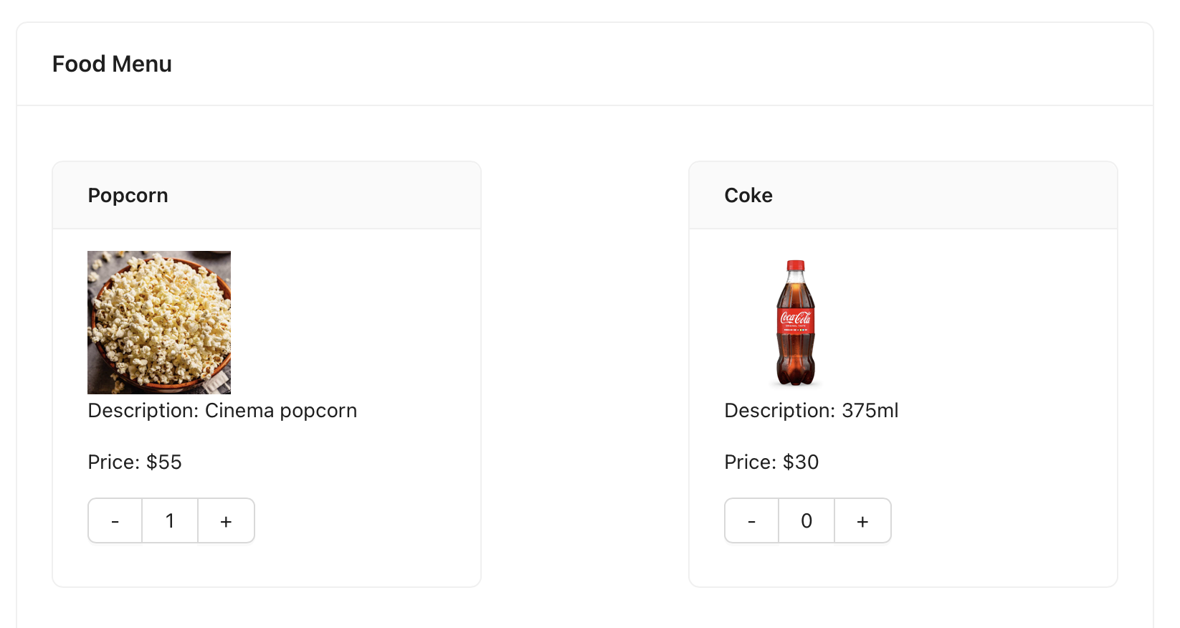
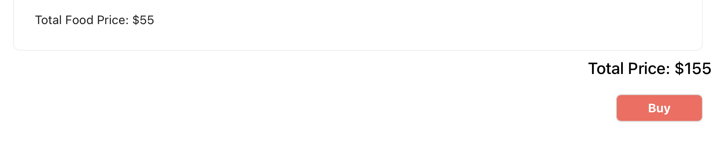
Find Movies
Find Cinemas
Choose Movie Sessions
Login Account
Buy Movie Tickets
Waiting
Go to watch movie
Share Comments
User Activities

Slide 15
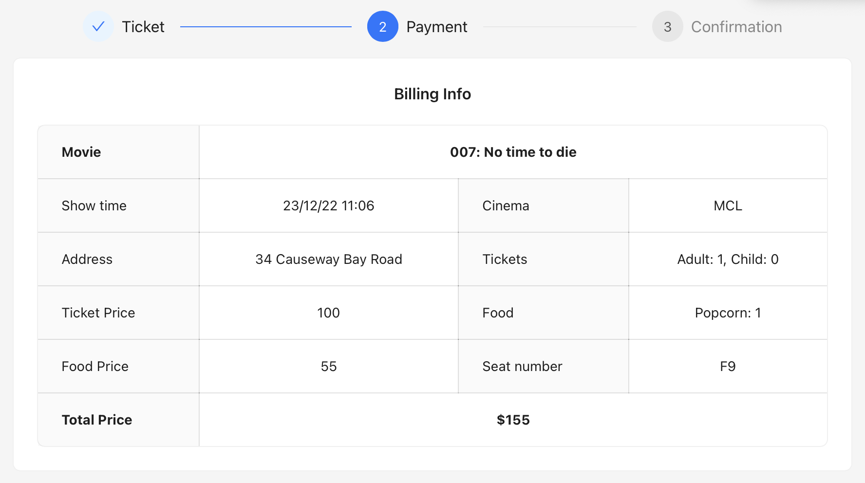
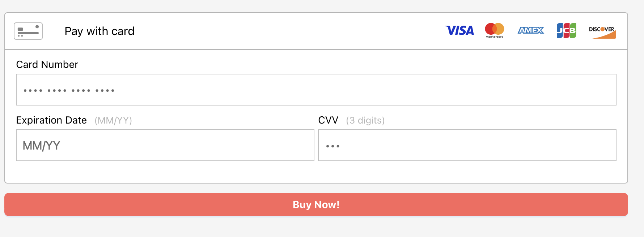
Find Movies
Find Cinemas
Choose Movie Sessions
Login Account
Buy Movie Tickets
Waiting
Go to watch movie
Share Comments
User Activities

Slide 16
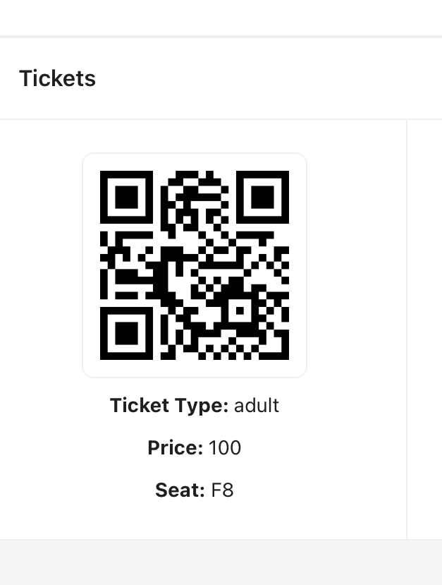
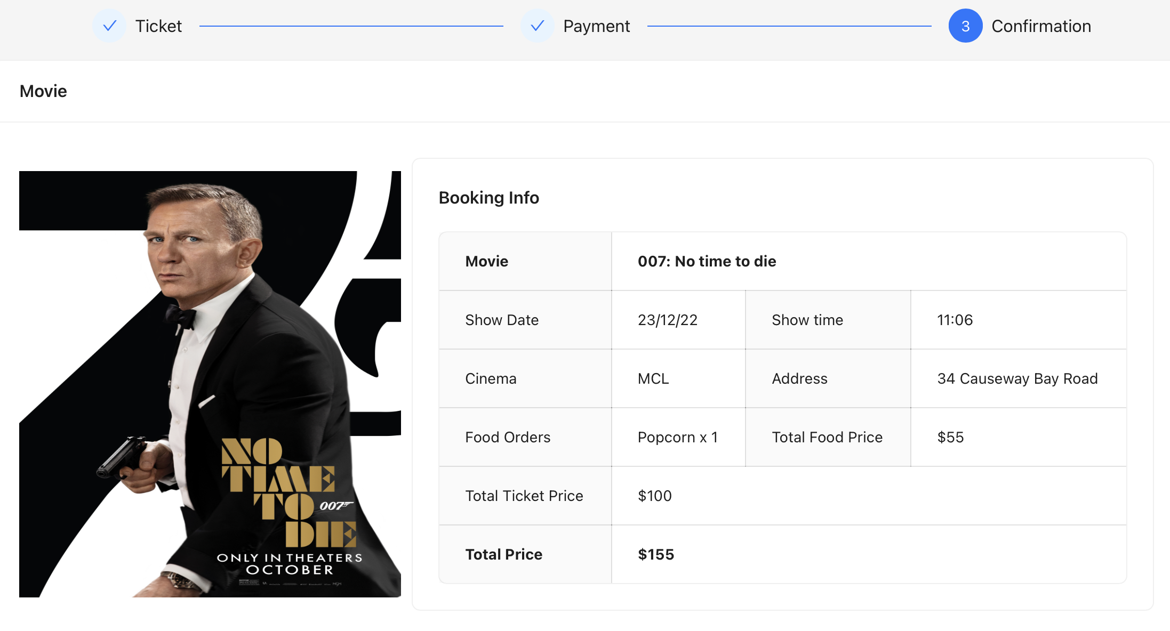
Find Movies
Find Cinemas
Choose Movie Sessions
Login Account
Buy Movie Tickets
Waiting
Go to watch movie
Share Comments
User Activities

Slide 17
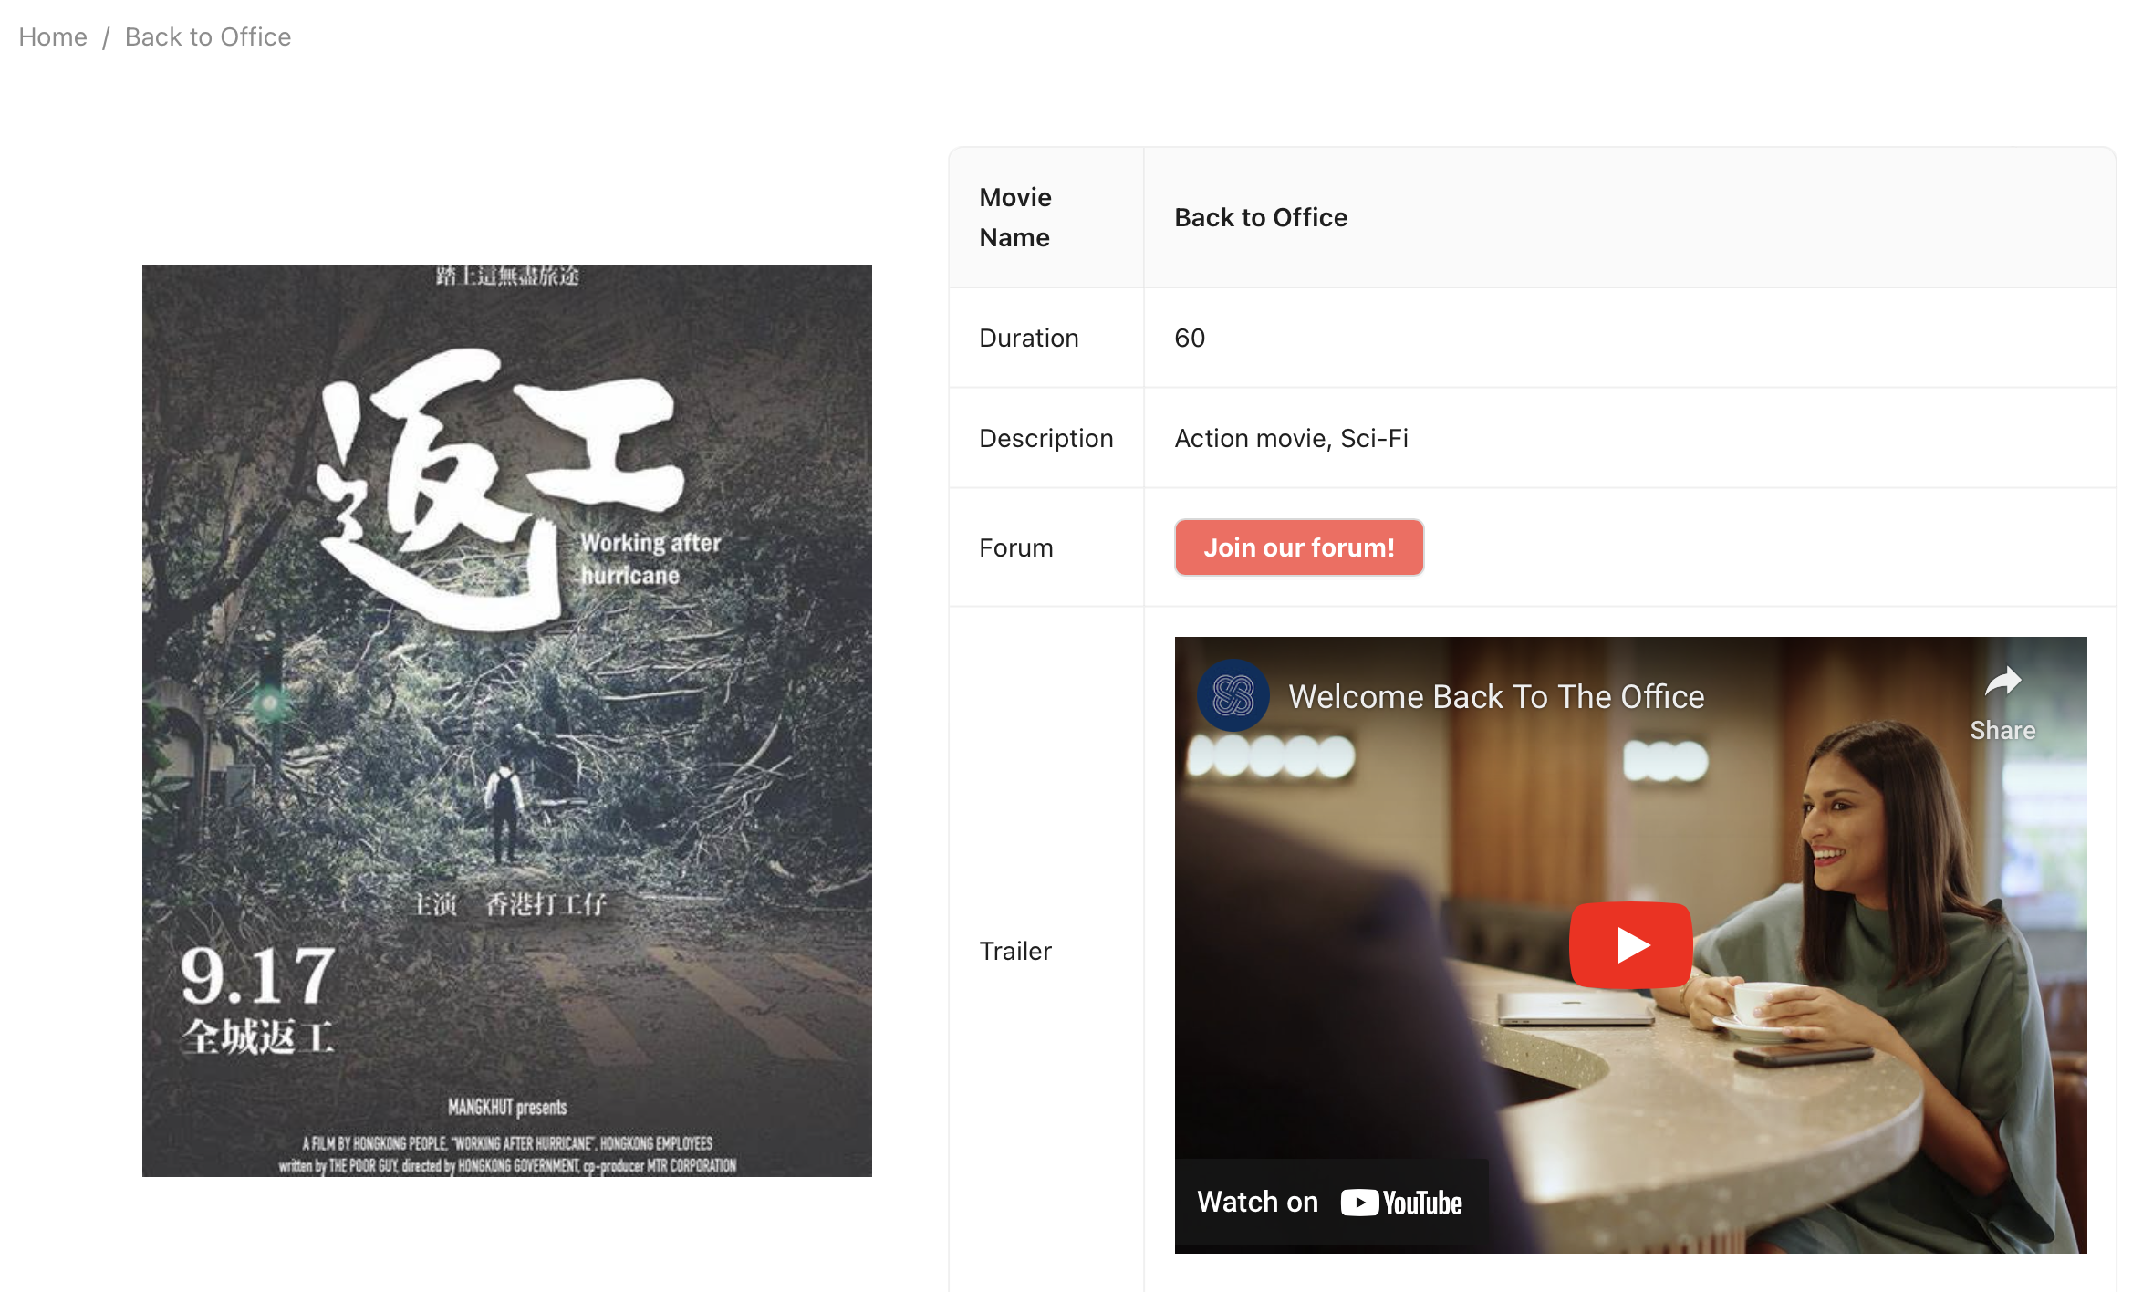
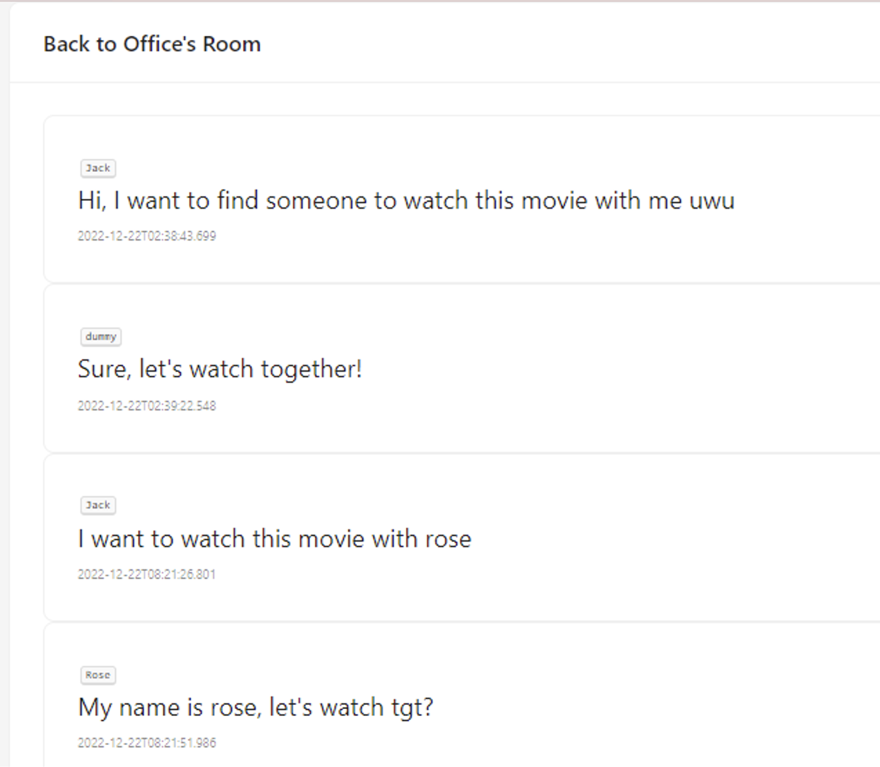
Find Movies
Find Cinemas
Choose Movie Sessions
Login Account
Buy Movie Tickets
Waiting
Go to watch movie
Share Comments
User Activities

Slide 18
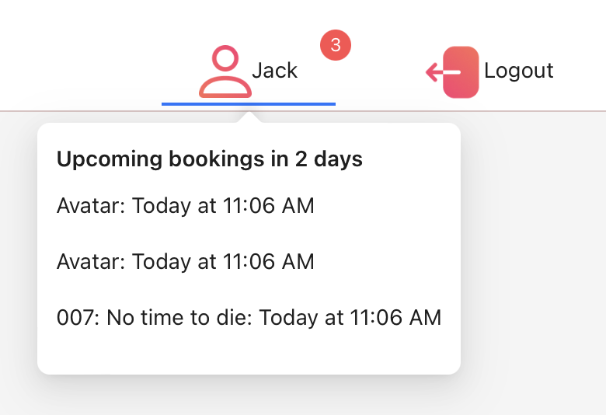
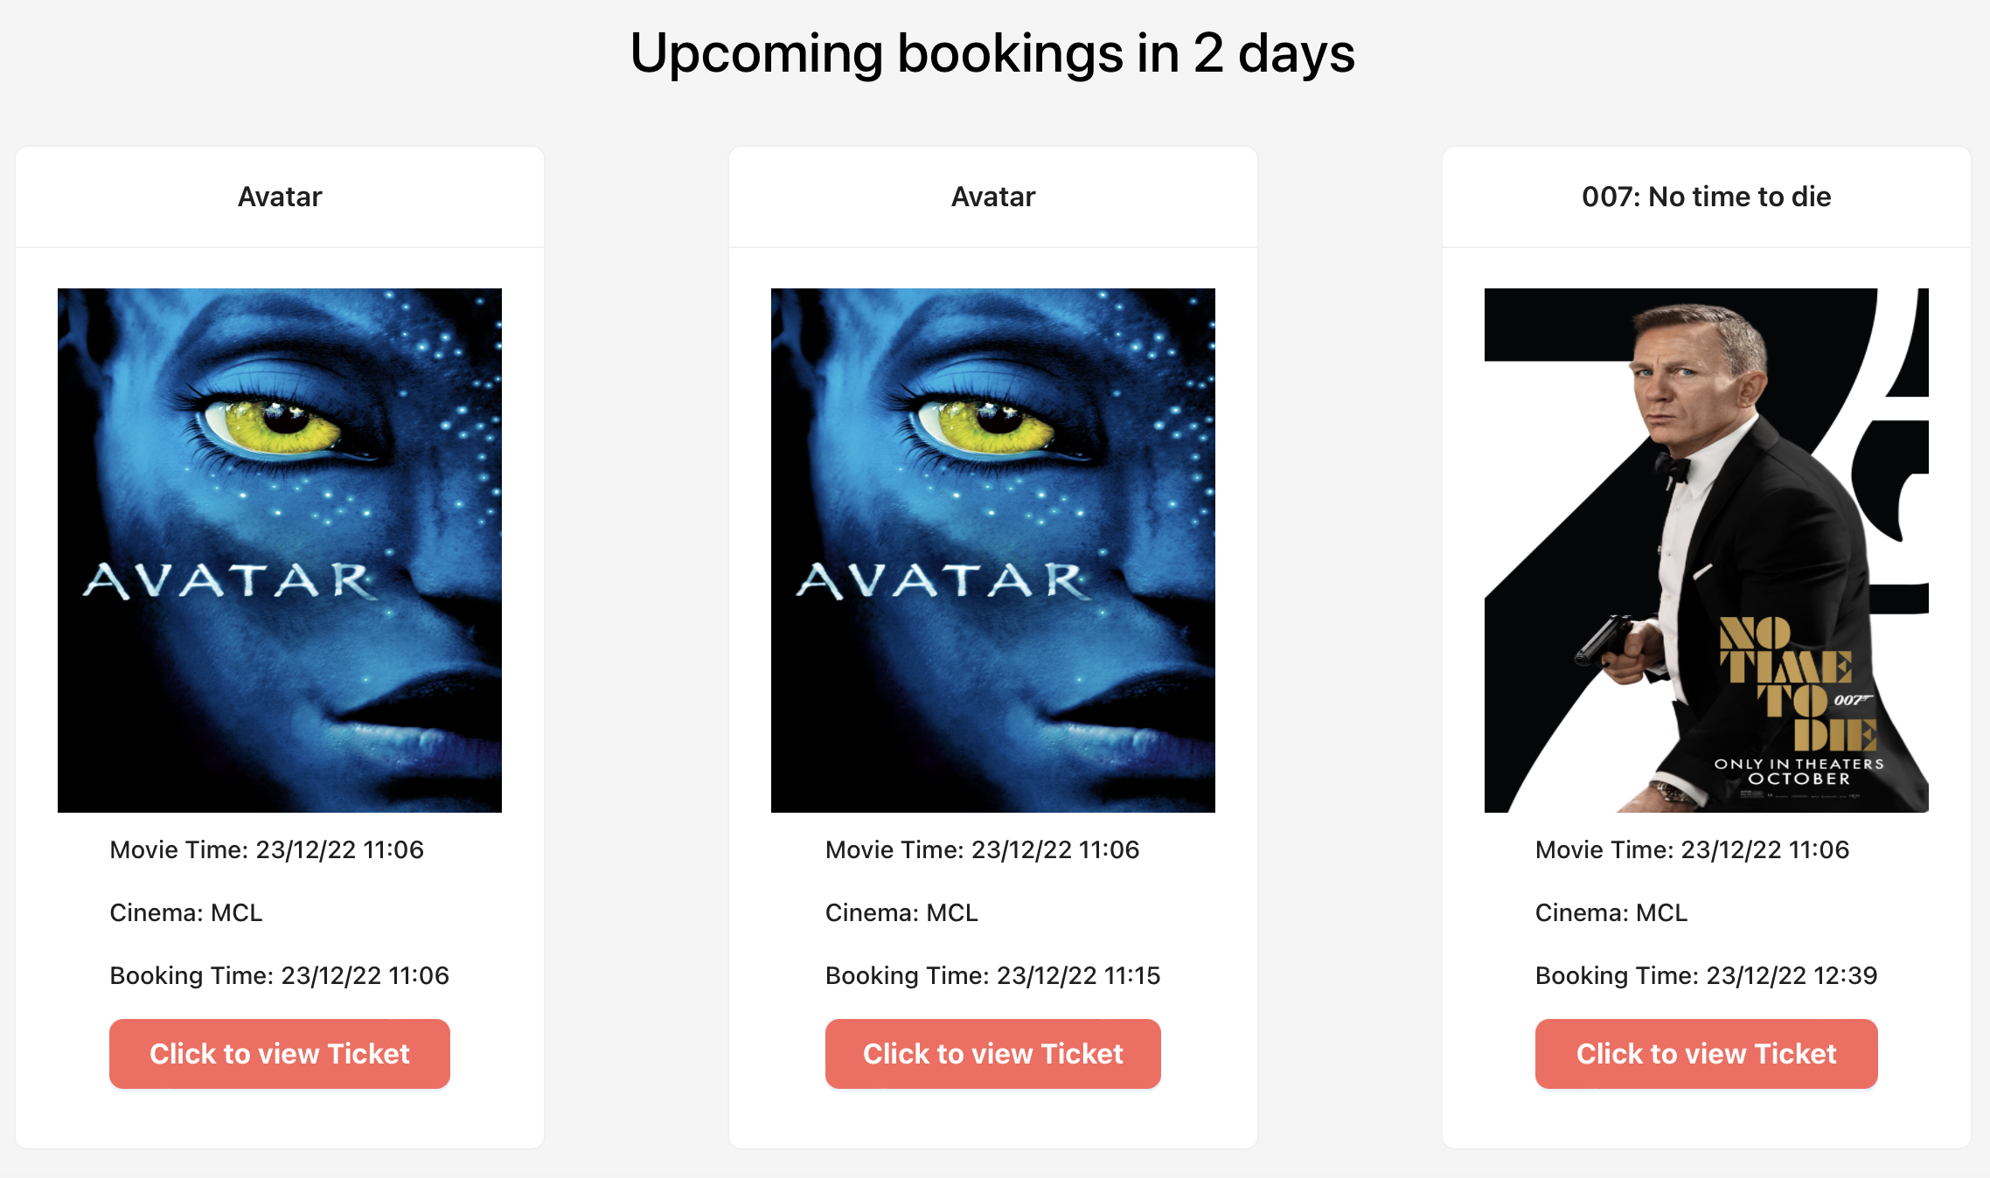
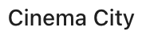
Find Movies
Find Cinemas
Choose Movie Sessions
Login Account
Buy Movie Tickets
Waiting
Go to watch movie
Share Comments
User Activities

Slide 19
Find Movies
Find Cinemas
Choose Movie Sessions
Login Account
Buy Movie Tickets
Waiting
Go to watch movie
Share Comments
User Activities

Slide 20
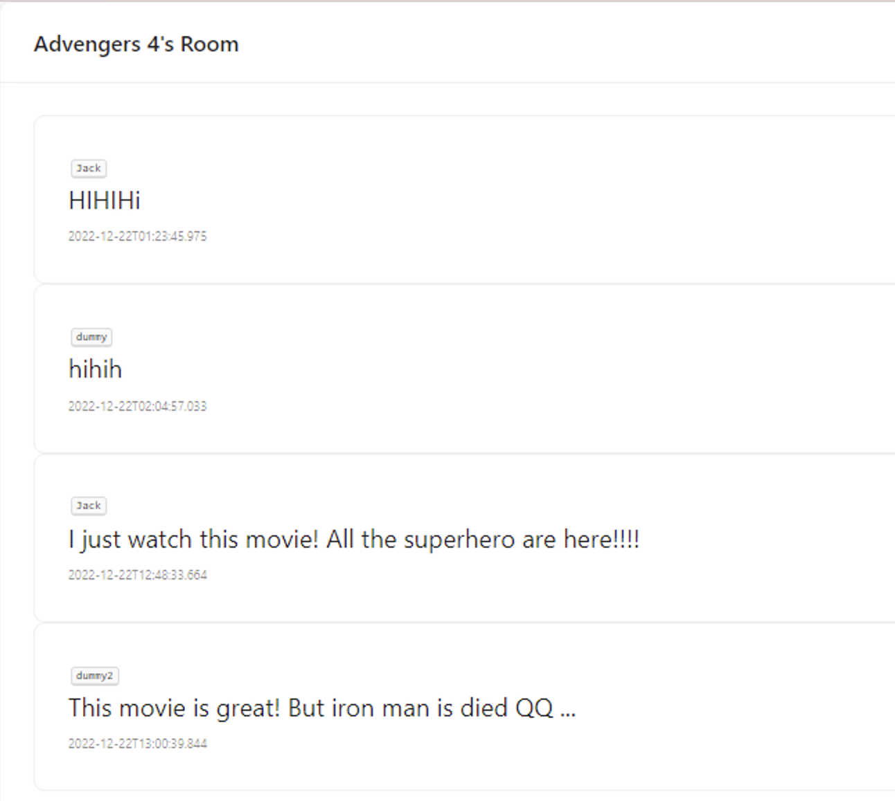
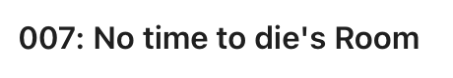
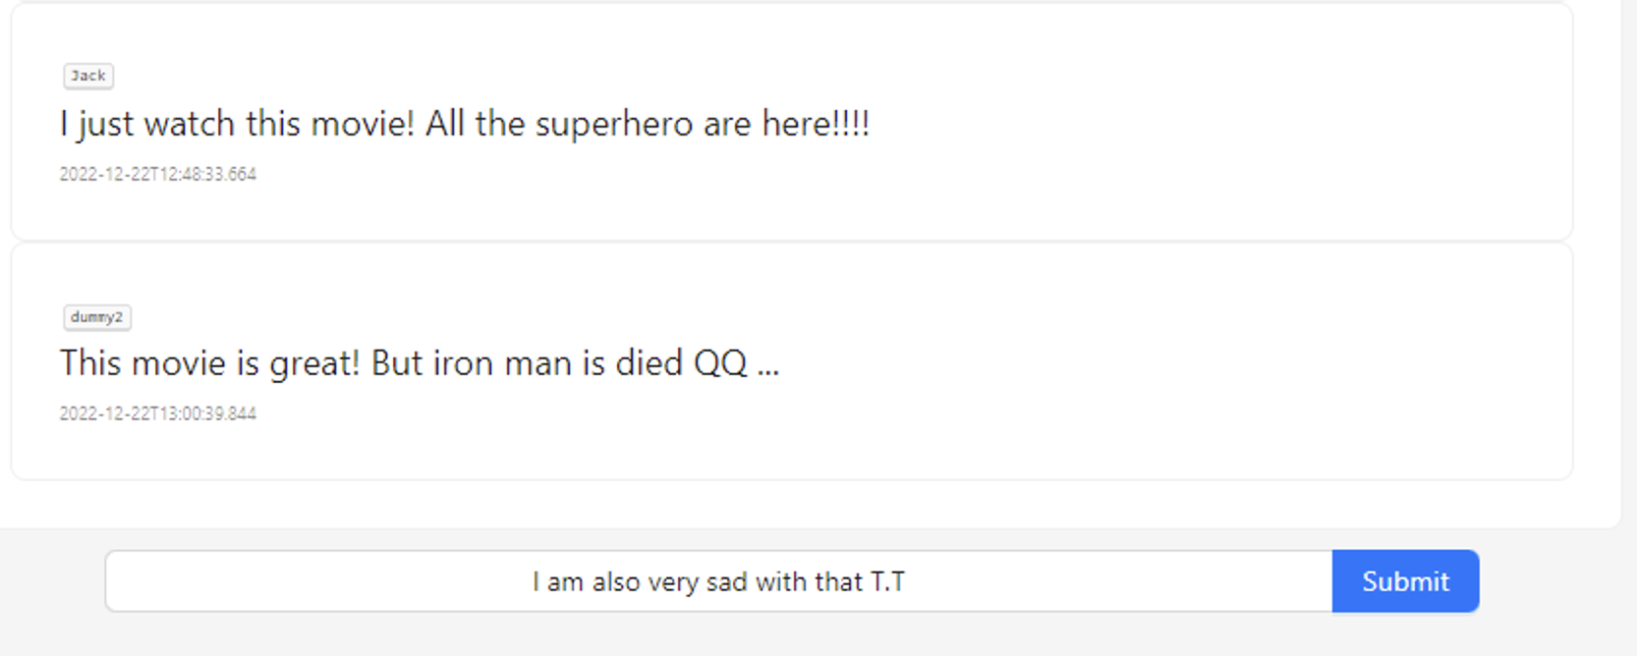
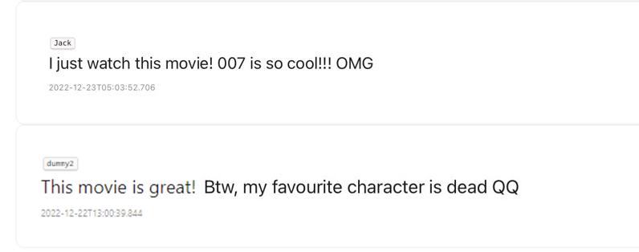
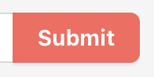

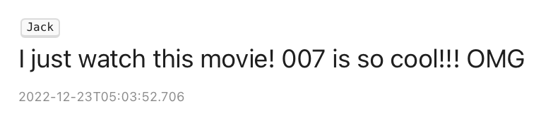
Find Movies
Find Cinemas
Choose Movie Sessions
Login Account
Buy Movie Tickets
Waiting
Go to watch movie
Share Comments
User Activities

Slide 21


Product Introduction - Advantages
All-in-one movie ticket reservation platform
(Movie searching + Ticket Reservation + Real Time Forum)
01
Fast
02
Convenient
03
04
Bond the users together -> Stick on our platform
Provide Warm Personal Reminders

Slide 22
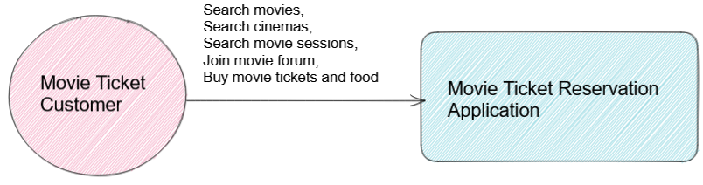
Architecture – Context Level

Slide 23
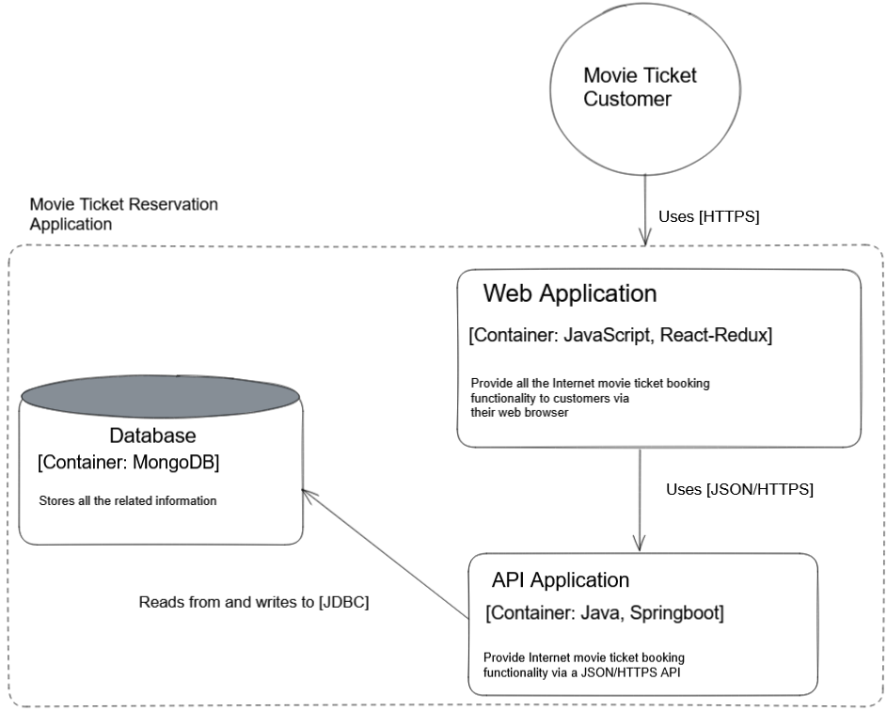
Architecture – Container Level

Slide 24
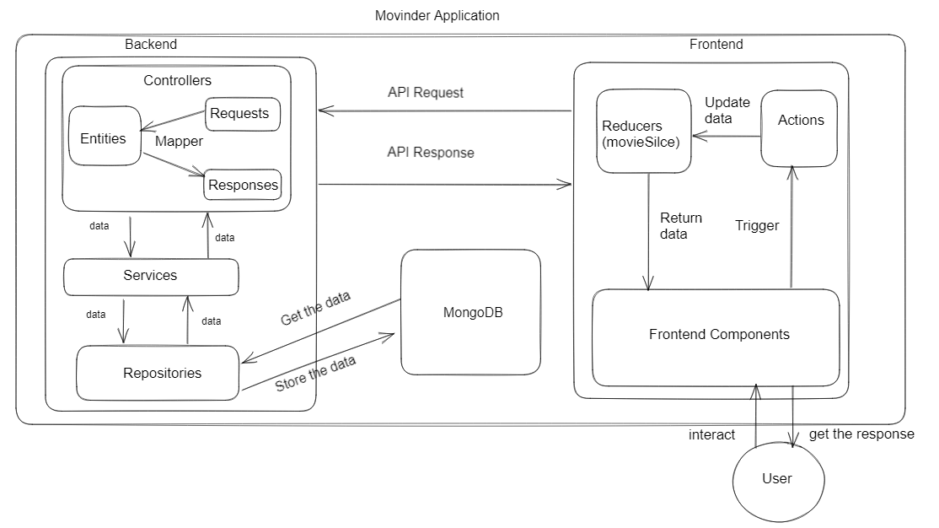
Architecture – Component Level

Slide 25
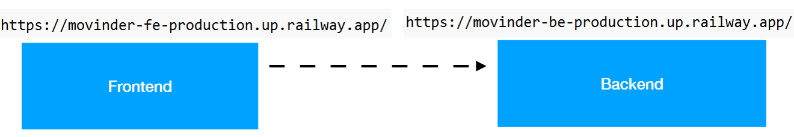
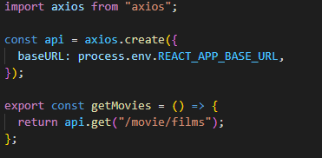
CORS & Axios
CORS configuration enables front-end back-end communication
Axios enables sending Http request to backend server

Slide 26
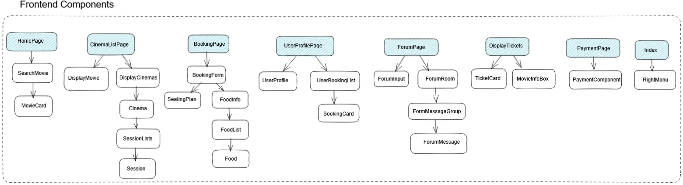
Architecture – Component Level (Frontend)

Slide 27
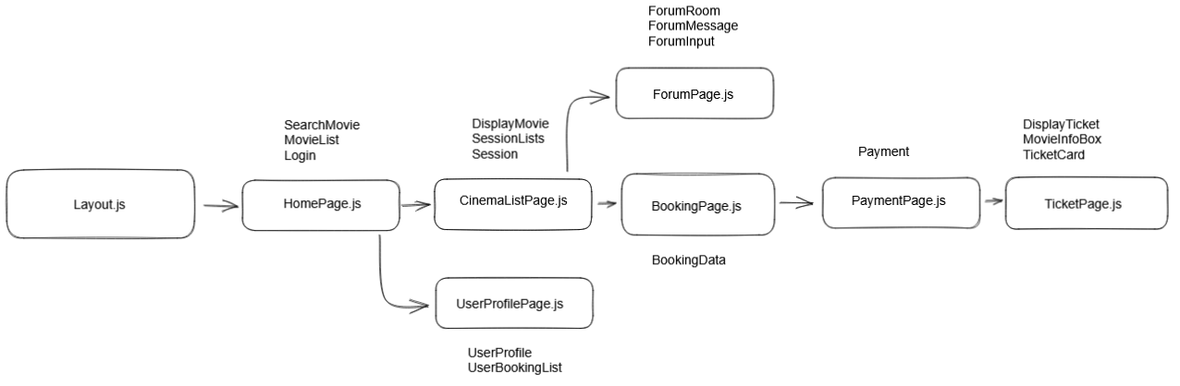
Architecture – Component Level (Frontend Flow)

Slide 28





Front End Architecture
UI design
Global Store
HTTP Request

Slide 29
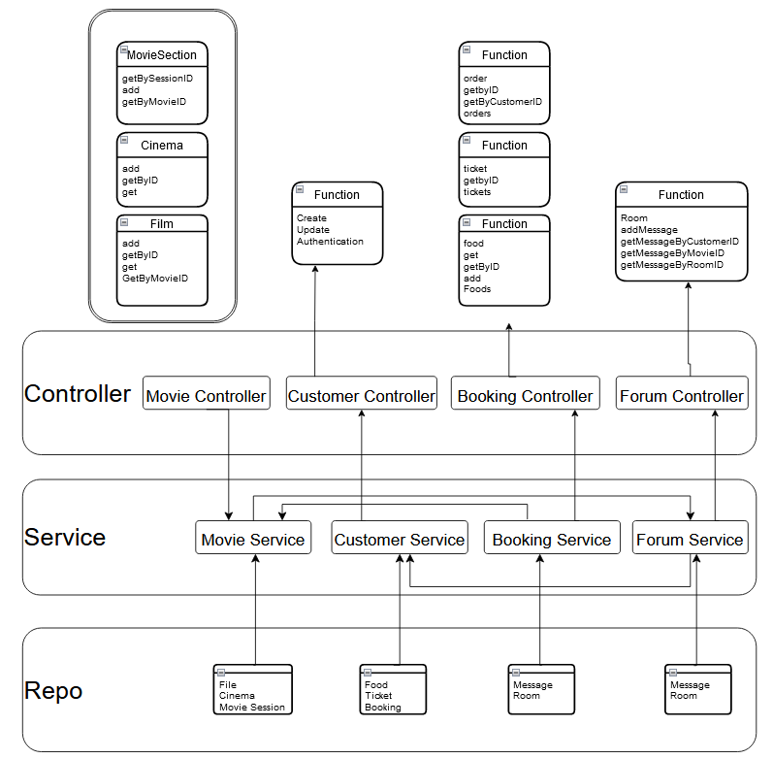
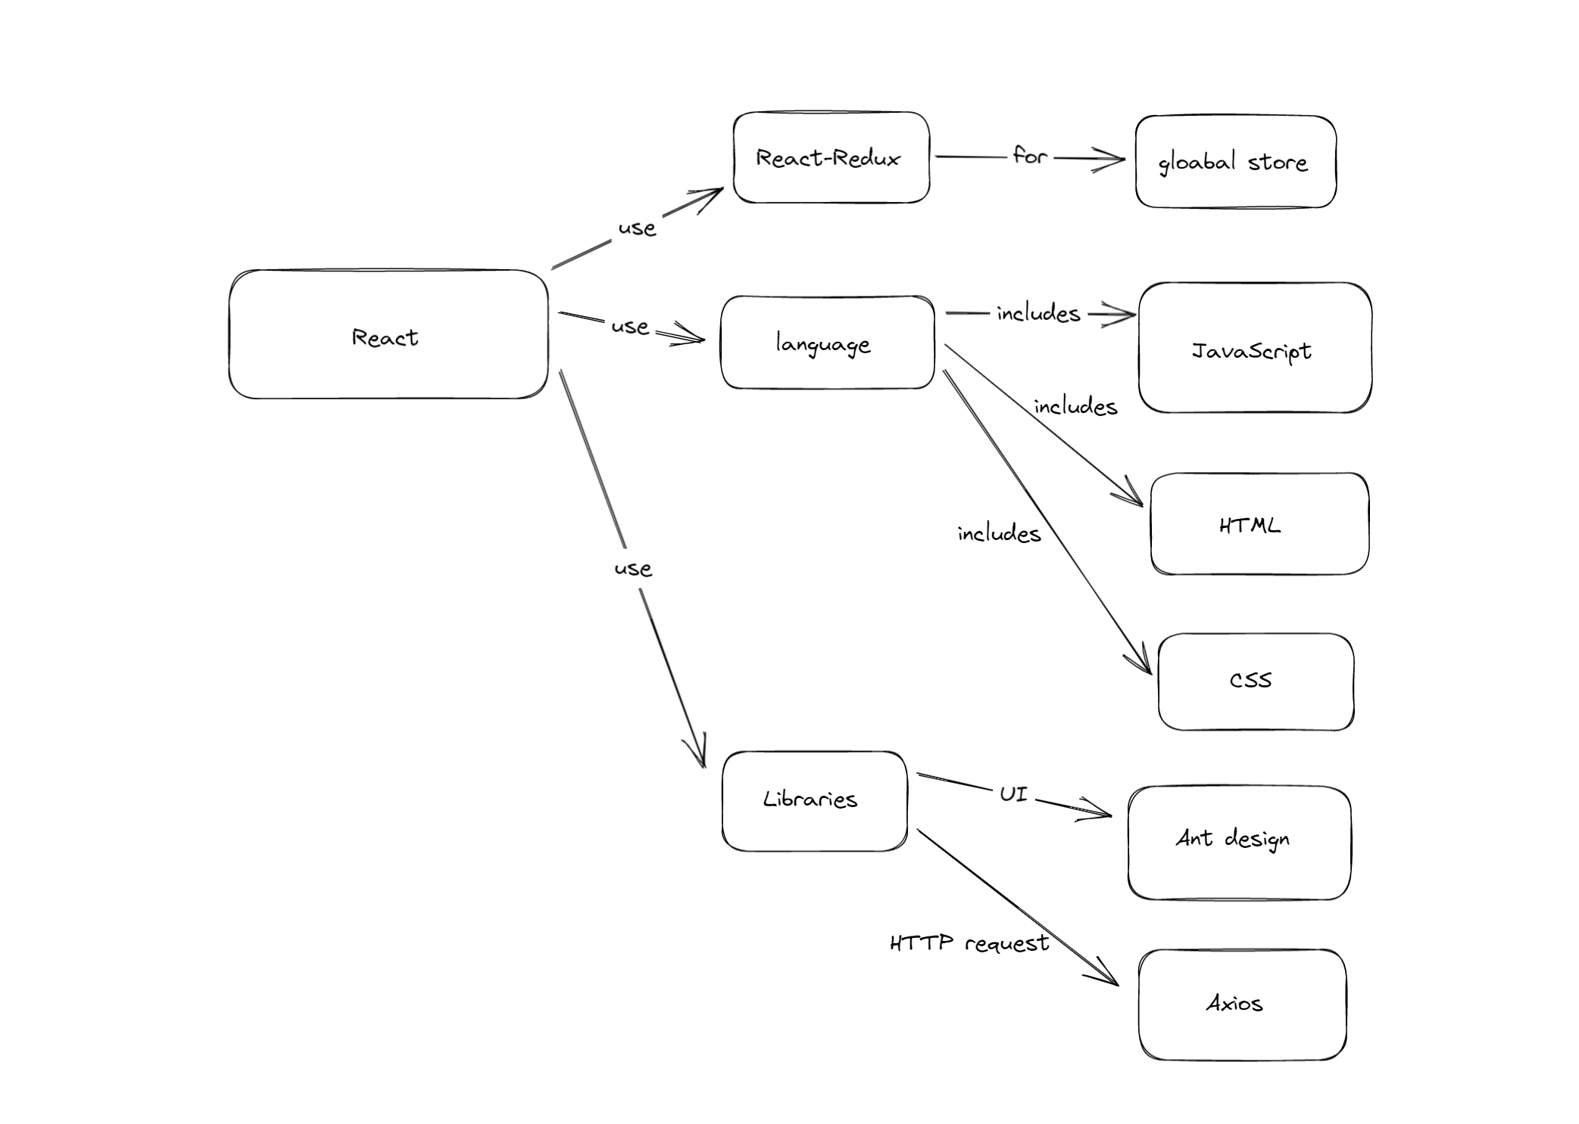
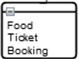
Architecture
Component Level (Backend)
customer

Slide 30
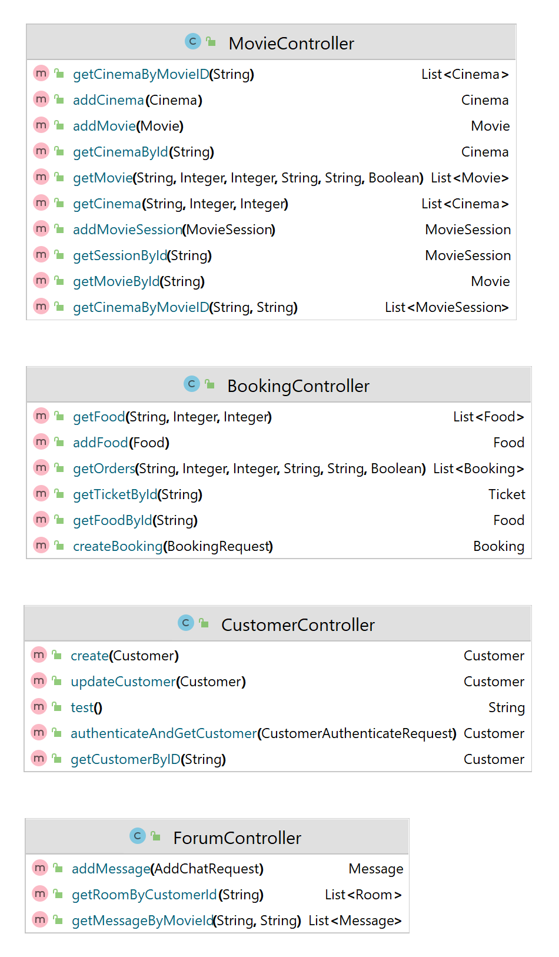
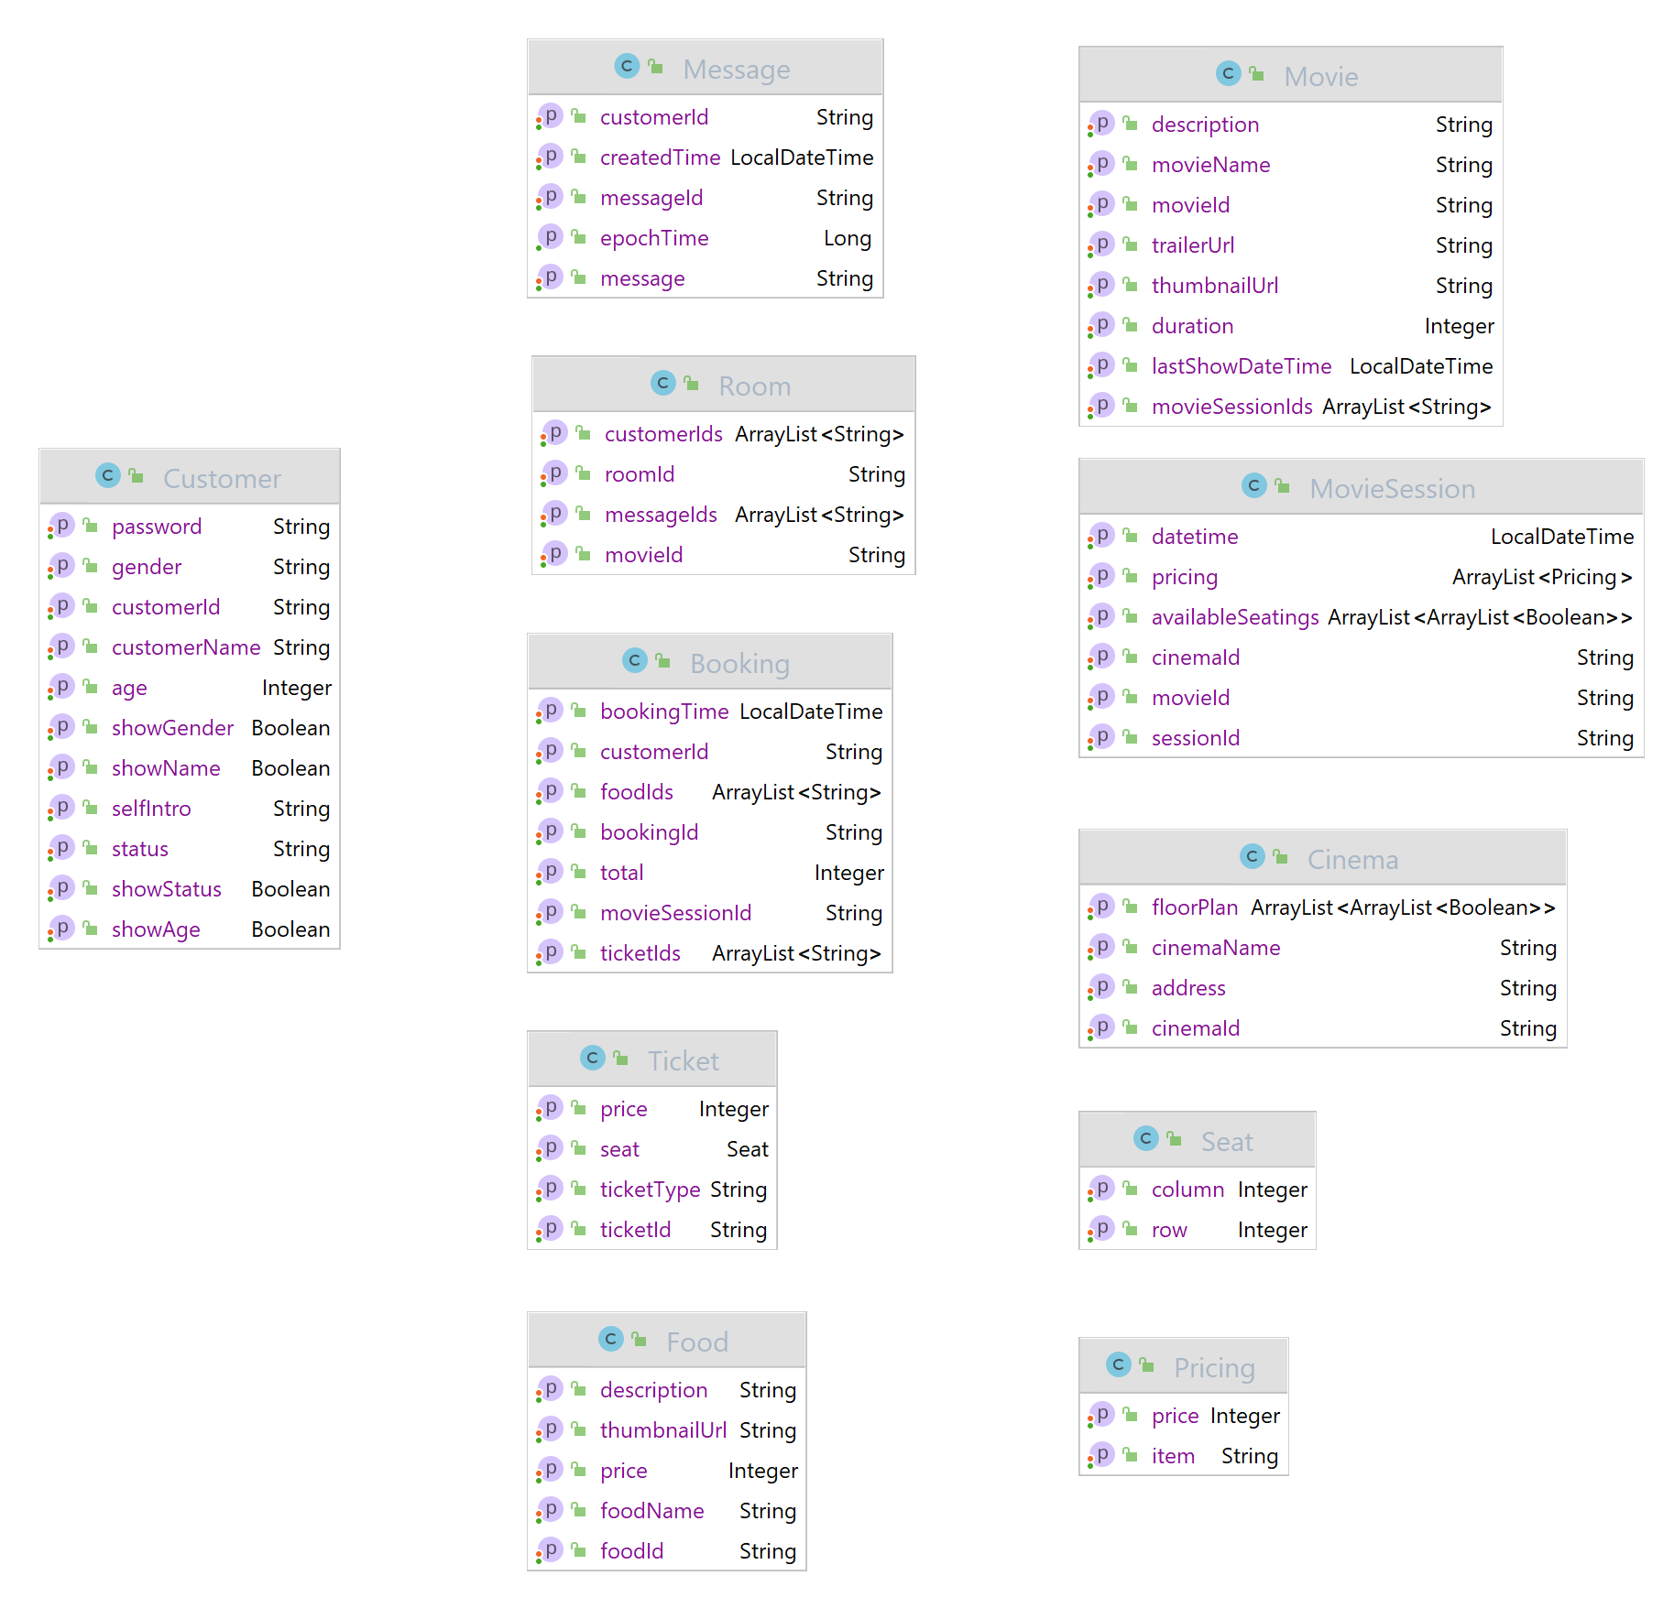
Architecture – Code Level (Backend)

Slide 31
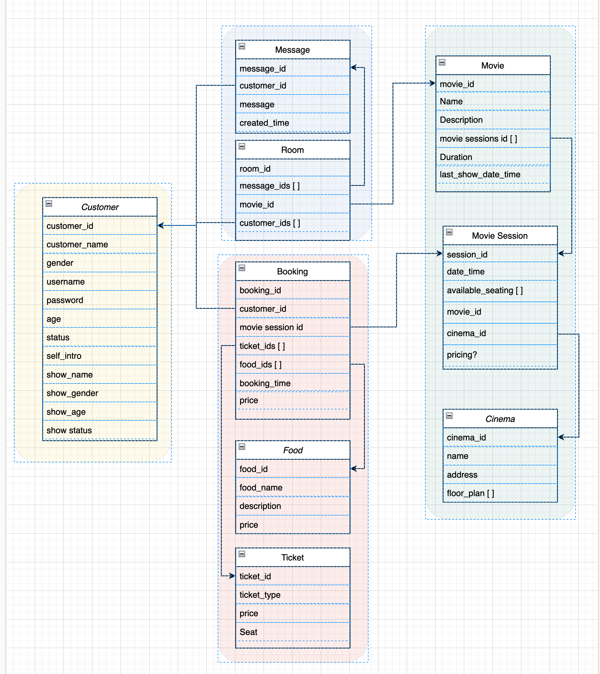
Database
Main Entities:
1. Customer
Index: customer_name
2. Forum
Room: Index: movie_id
Message
3. Booking
Booking: Index: customerId, movieSessionId
Food: Index: food_name
Ticket
4. Movie:
Movie: Index: movieName, lastShowDateTime
Movie Session
Cinema: Index: cinemaName

Slide 32
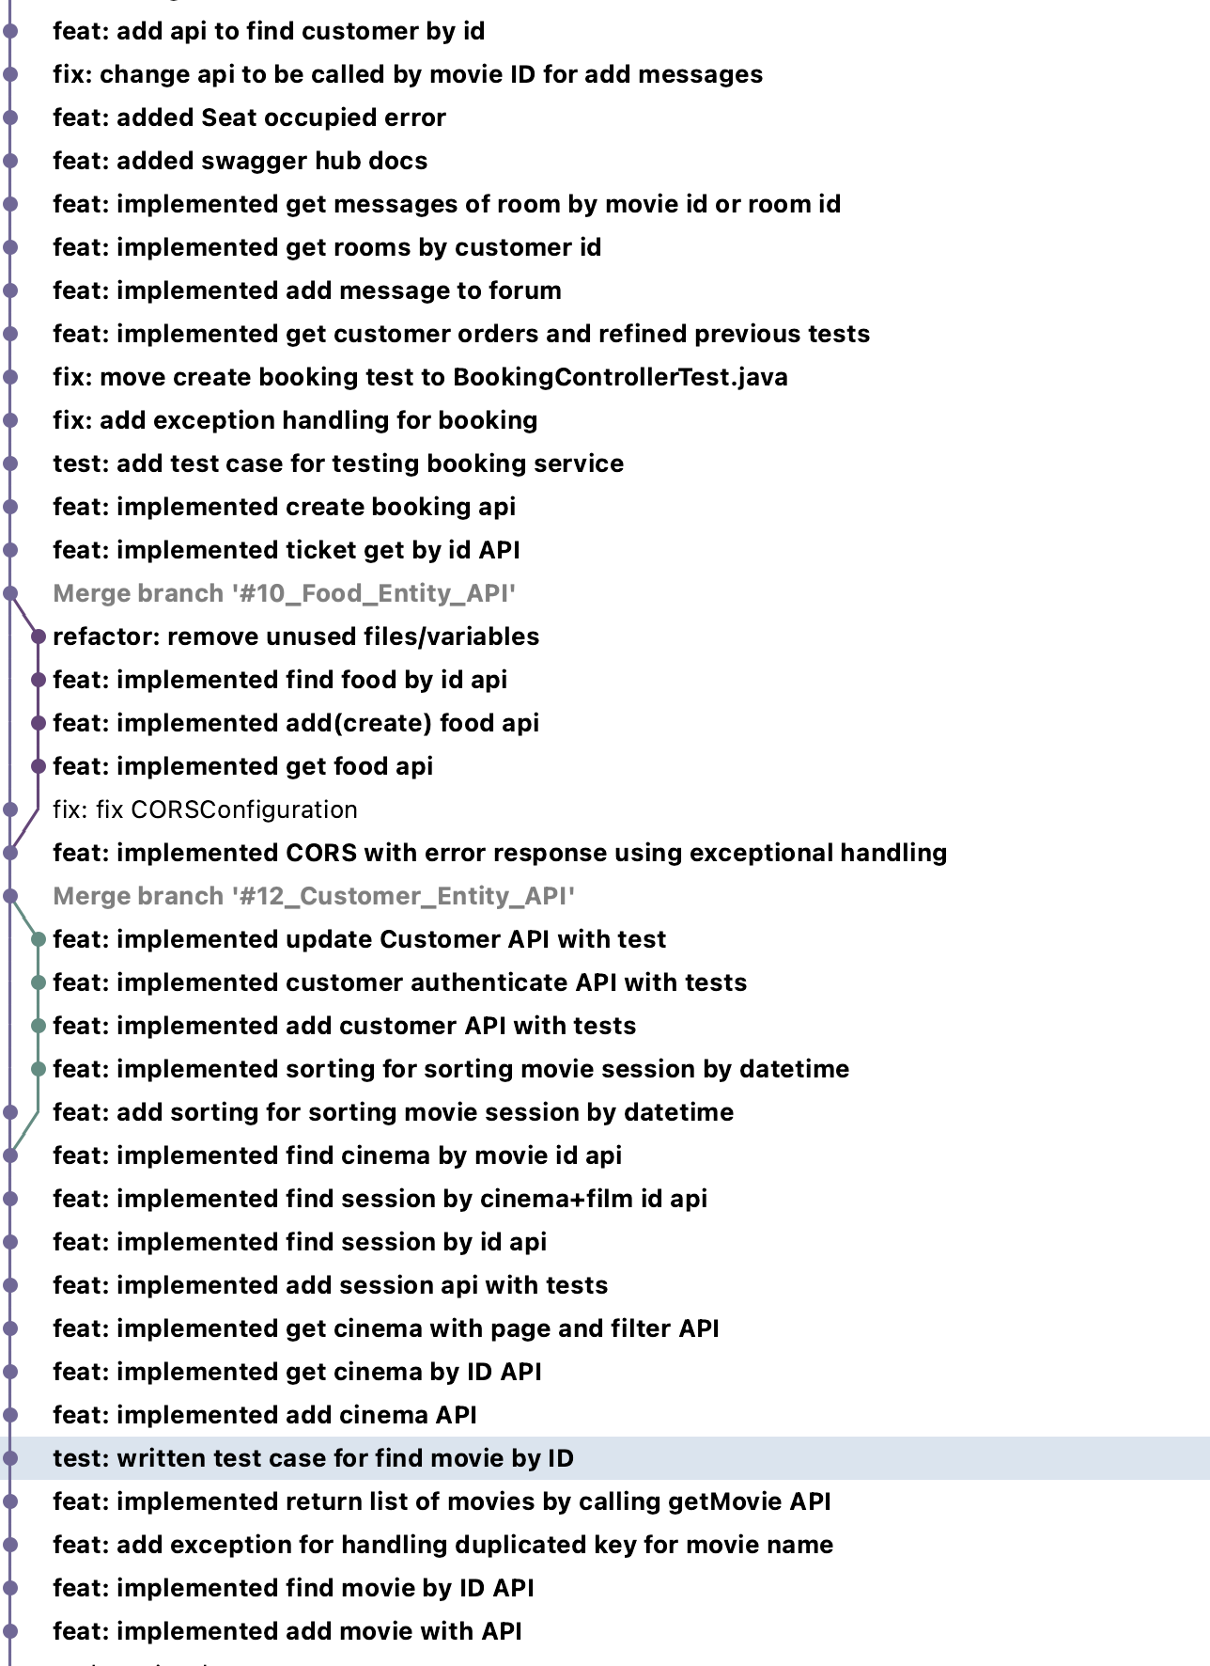
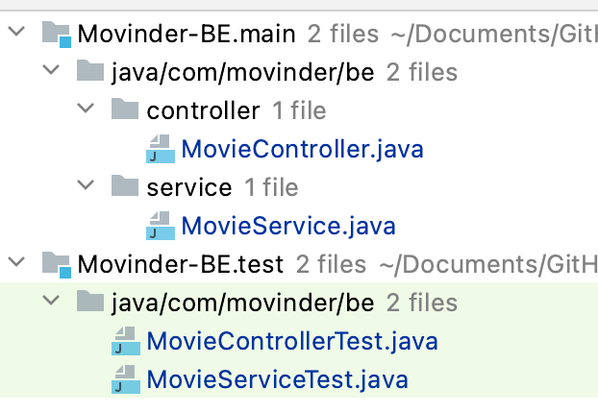
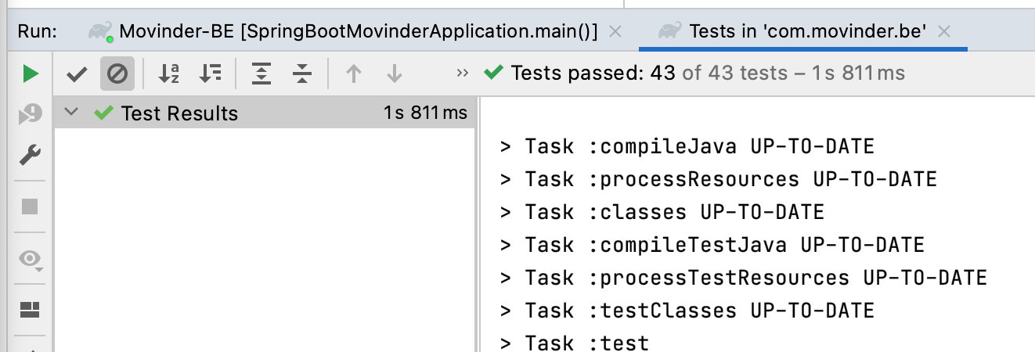
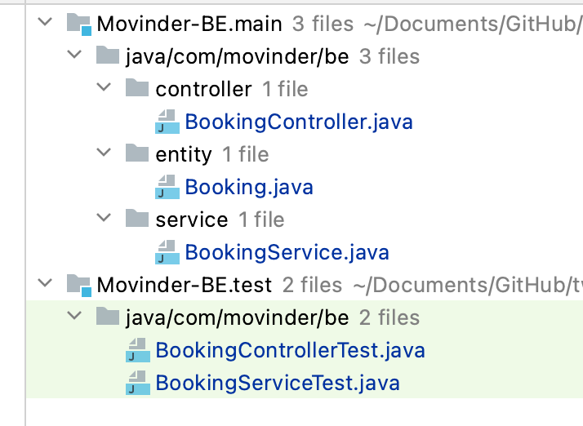
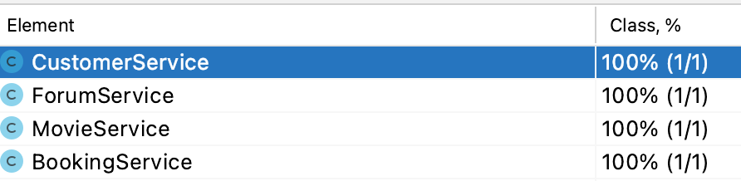
Test Driven Development
TDD
Each API is developed with a test case first approach
Full integration and mock testing is done for each API
Providing a reliable safety net to handle changing requirements

Slide 33
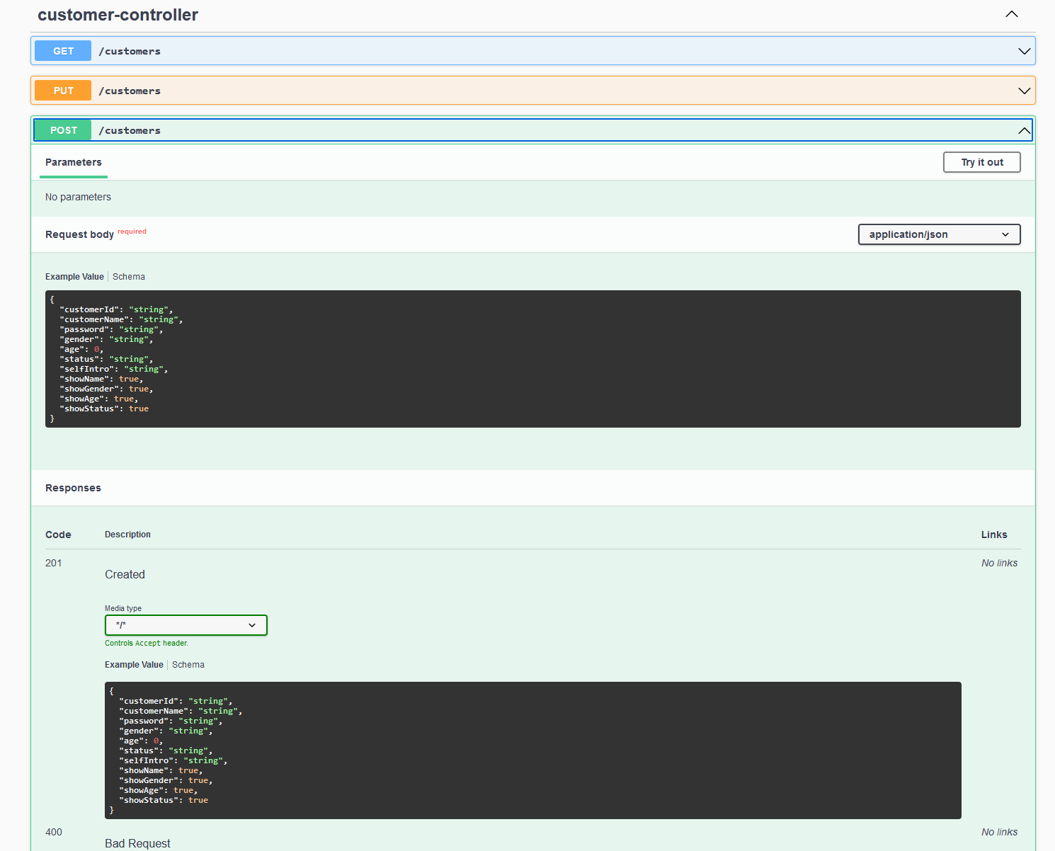
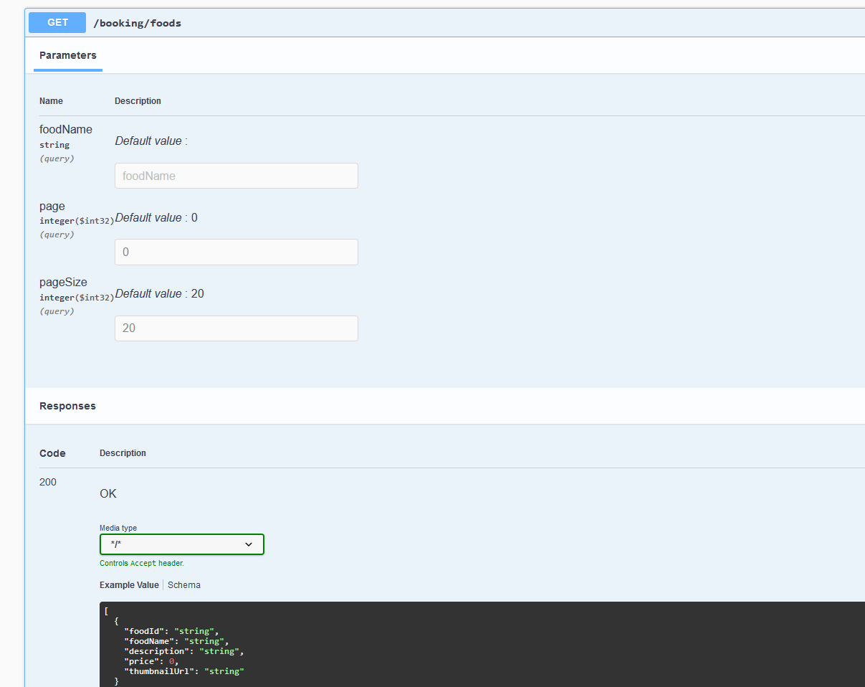
Documented API
API Documentation
Documentation is provided for each API using swagger hub
No more second guessing of API endpoints , params and their default value

Slide 34



Postman Collection
Postman
Postman collection is created for testing all APIs
Quick testing feedback loop for developers
Simplify testing lifecycle and streamline collaboration

Slide 35



Ensured Data Integrity
Data Integrity and Error Handling
Checking for all incoming client provided data
Meaningful error message
Error code allow easier front-end development

Slide 36
Demo Time

Slide 37

Development Process - Agile Flow
Architecture
Agile Practice

Slide 38
Agile Flow
Architecture
Agile Practice

Slide 39

KanBan

Slide 40
Agile Flow
Architecture
Agile Practice

Slide 41

IPM
Story point (workload estimation)
Priority

Slide 42
Agile Flow
Architecture
Agile Practice

Slide 43
Stand up meeting (~10mins)
Update Progress
Blockers
Story kick-off
Sync up Developers / QA / BA before development
Understand story, share ideas
Desk check
Demo in-dev functionality
Catch obvious defects
Code review
Check code smell
Review last yesterday code
Daily:
Stand up meeting
Story kick-off
Desk check
Code review

Slide 44
Agile Flow
Architecture
Agile Practice

Slide 45
Agile Flow
Architecture
Agile Practice

Slide 46


anonymous
Retrospective
(Retro)
Secure score
(1-5)

Slide 47
Development process – Story card lifecycle
Backlog
01
05
Ready for QA
In Analysis
02
06
In QA
Ready for Dev
03
07
QA Done
In Dev
04
08
Production

Slide 48

CI/CD

Slide 49

Continuous Integration
QA: For QA testing
Main (CI): For merging code, scanning codesmell
XX_story: For story

Slide 50




CI

Slide 51


Continuous Delivery

Slide 52
Release Timeline
19 DEC
20 DEC
21 DEC
22 DEC
23 DEC
Cinemas list Display
Movies List Display
Movie Sessions List Display
Movie Ticket Purchase
Food Purchase
Login
Movie Forum
Payment
User Profile
Ticket history
Personal Reminder
Search function
Enhance the UI
A complete ticket reservation website

Slide 53
Future Plan
UI/UX
Enhance the UI/UX
UI/UX
Cross Platform
Support Different Platform
Private Chat
Cross Platform
Allow customers to communicate privately
Private Chat
Reward System
Reward users that support the matching feature. E.g. Free ticket, etc...
Reward System

Slide 54


Future Enhancements
Features
Support Different Platform

Slide 55

Future Enhancements
Features
Private Chat​

Slide 56

Future Enhancements
Features
Reward System

Slide 57
Thank You~

Slide 58
Enhancements
Features
Cinemas Searching
Movies Searching
Movie Sessions Searching
Movie Ticket and Food Purchase At Once
Real Time Movie Forum
Personal Reminders

Slide 59
Fully Editable Icon Sets: A

Slide 60
Fully Editable Icon Sets: B

Slide 61
Fully Editable Icon Sets: C

Slide 62

Choose a movie session | Buy a movie ticket | Got to watch the movie
No friends like to watch that movie
Takes time to queue in cinema
Forgets about the movie time and date
Architecture
Lost or damage movie ticket
No friends free to watch together
User
Journey
Product Introduction

Slide 63

Future Enhancements
Features
Movies Searching

Slide 64

Enhancements
Features
Cinemas Searching Movie Sessions Searching

Slide 65


Enhancements
Features
Movie Ticket and Food Purchase At Once

Slide 66


Enhancements
Features
Real Time Movie Forum

Slide 67

Enhancements
Features
Personal Reminders

Slide 68
Movinder
Team M gogogo

Slide 69
Team Introduction
Team M gogogo
Iterations | Tech Lead | UX | BA | DEV_1 | DEV_2 | DEV_3 | QA
Iteration 1 | Marie | Vincent | Chris | Alan | Thomas | Heinrich | Jenny
Iteration 2 | Marie | Vincent | Jenny | Chris | Alan | Thomas | Heinrich
Iteration 3 | Marie | Vincent | Heinrich | Jenny | Chris | Alan | Thomas
Iteration 4 | Marie | Vincent | Thomas | Heinrich | Jenny | Chris | Alan
Notes:
Self intro -> VALUE of position

Slide 70
Team Introduction – Roles and Responsibilities (Iteration 2)
Team Lead:
Responsible for the technical troubles of the team
Ensure all the agile activities happen
Control the progress and guide the priority
Notes:
Don’t really need these -> just look at p.2 and talk

Slide 71
Team Introduction – Roles and Responsibilities (Iteration 2)
BA:
Clarify Requirements through the communications
Communicate with PO and the team
Manage the IPM
Collaborate with QA and DEV in Story Kickoff and Desk check
Ensure everyone has a clear and consistent understanding of the story cards

Slide 72
Team Introduction – Roles and Responsibilities (Iteration 2)
UX/UI: Design the UI
DEV: Development

Slide 73
Team Introduction – Roles and Responsibilities (Iteration 2)
QA:
Collaborate with BA and DEV in Story Kickoff
Make sure the story card contains all the information and has clear description and ACs
Collaborate with BA and DEV in Desk check
Ensure that all ACs are implemented and all functions are working properly through QA testing

